Slide 1
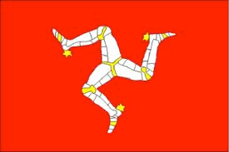
Gaelg

Slide 2
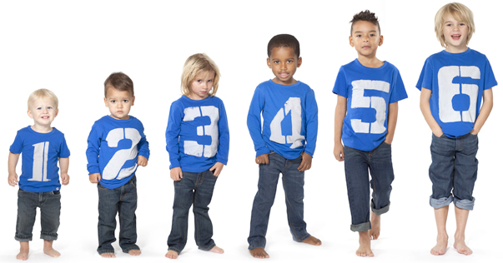
Quiss/Quizz - I can say how old I am.
?

Slide 3
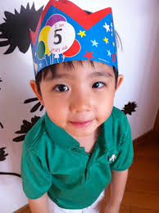
Click the sentence which matches up with how old people are.
a. Ta mee tree bleeaney d’eash.
b. Ta mee queig bleeaney d’eash.
c. Ta mee nuy bleeaney d’eash.

Slide 5
Click the sentence which matches up with how old people are.
a. Ta mee kiare bleeaney d’eash.
b. Ta mee tree bleeaney d’eash.
c. Ta mee jeih bleeaney d’eash.

Slide 7
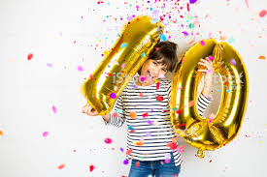
Click the sentence which matches up with how old people are.
a. Ta mee un vlein d’eash.
b. Ta mee hoght bleeaney d’eash.
c. Ta mee jeih bleeaney d’eash.

Slide 9
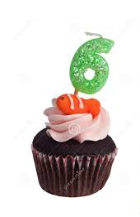
Click the sentence which matches up with how old people are.
a. Ta mee nuy bleeaney d’eash.
b. Ta mee shey bleeaney d’eash.
c. Ta mee shiaght bleeaney d’eash.

Slide 11
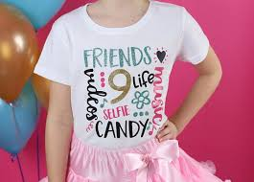
Click the sentence which matches up with how old people are.
a. Ta mee nuy bleeaney d’eash.
b. Ta mee daa vlein d’eash.
c. Ta mee shiaght bleeaney d’eash.

Slide 13
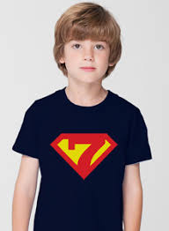
Click the sentence which matches up with how old people are.
a. Ta mee shey bleeaney d’eash.
b. Ta mee shiaght bleeaney d’eash.
c. Ta mee nuy bleeaney d’eash.

Slide 15
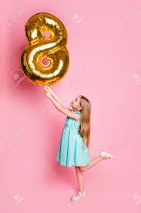
Click the sentence which matches up with how old people are.
a. Ta mee un vlein d’eash.
b. Ta mee hoght bleeaney d’eash.
c. Ta mee nuy bleeaney d’eash.

Slide 17
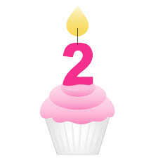
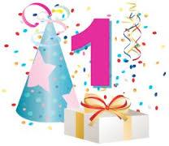
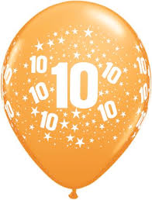
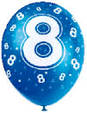
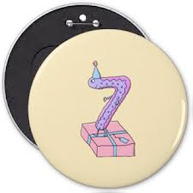
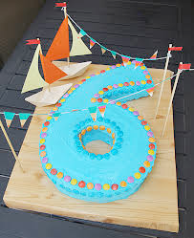
Jeant dy mie!/Well done!

