Slide 1
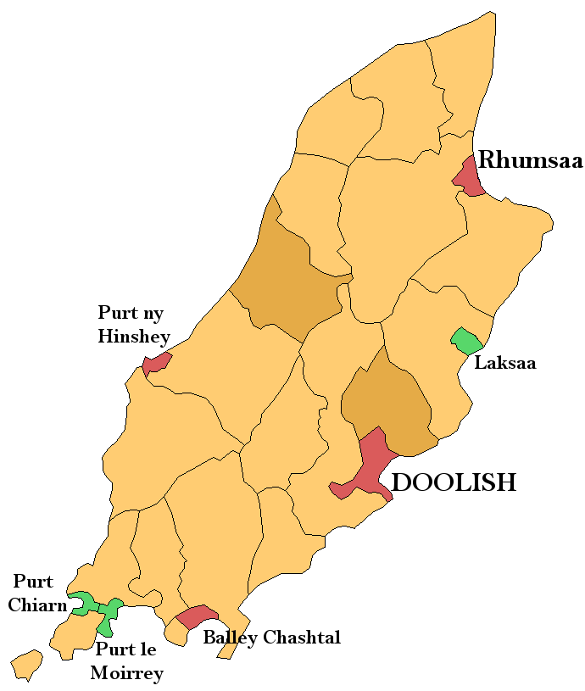
In this game, you can practise the Manx placenames you’ve learnt in PowerPoint 4.
Listen to where these people live and click on the matching picture.
Go to the next slide to see all the pictures and placenames on the map.
Ellan Vannin
Balley Keeill Eoin

Slide 2
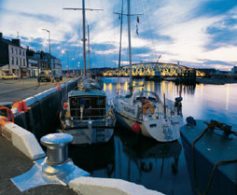
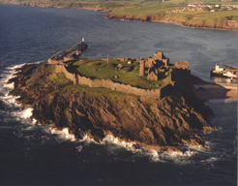
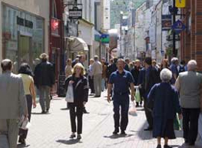
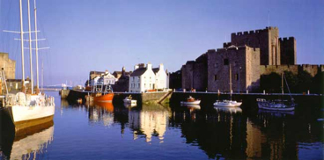
C’raad t’ou cummal?
(Where do you live?)
Balley Keeill Eoin
Click when you are
ready to start the game.

Slide 3
1 /9
C’raad t’ou cummal?
a. What’s your name?
b. How are you?
c. Where do you live?
d. How old are you?

Slide 5
2/ 9
Ta mee cummal ayns Doolish.
a
b
c
d

Slide 7
3/9
Ta mee cummal ayns Purt le Moirrey.
a
b
c
d

Slide 9
4/ 9
Ta mee cummal ayns Laksaa.
a
b
c
d

Slide 11
5/ 9
Ta mee cummal ayns Balley Chashtal.
a
b
c
d

Slide 13
6/ 9
Ta mee cummal ayns Rhumsaa.
a
b
c
d

Slide 15
7/ 9
Ta mee cummal ayns Purt ny h-Inshey.
a
b
c
d

Slide 17
8/ 9
Ta mee cummal ayns Purt Çhiarn.
a
b
c
d

Slide 19
9/ 9
Ta mee cummal ayns Balley Keeill Eoin.
a
b
c
d

Slide 21
Jeant
Finished

Slide 22
x

