Slide 1
Ceauyn Traa (Activities)
Traa son gamman!
(Time for a game!)
In this game, you can practise the activities you learnt in PowerPoint 5.
Go to the next slide for a quick recap.
When you are ready, click to start the game.

Slide 2
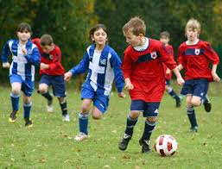
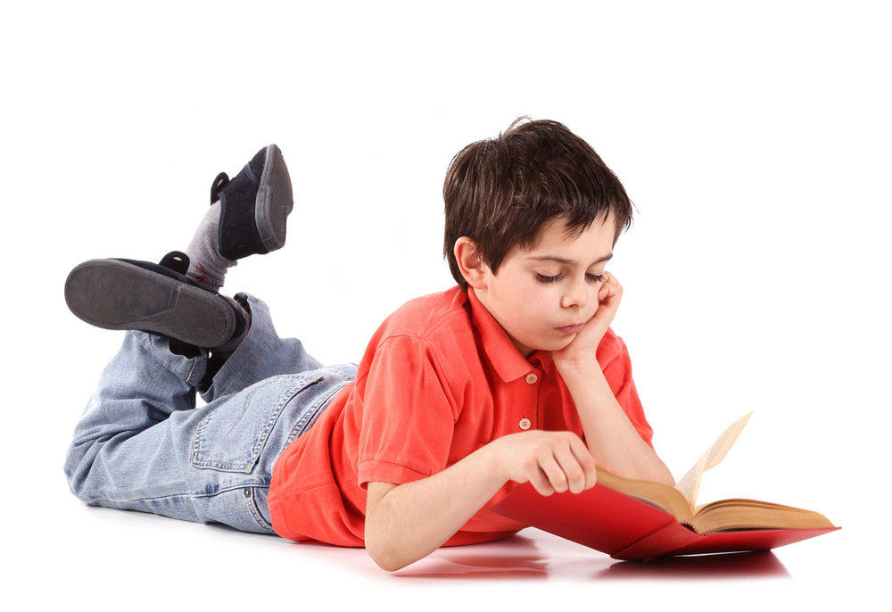
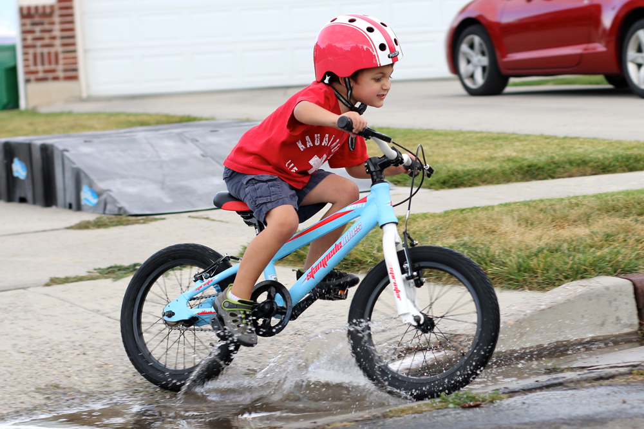
S’mie lhiam … Cha mie lhiam …
jeeaghyn er
y çhellveeish
roie
snaue
shooyl
cloie bluckan coshey
lhaih lioar
cloie
cloie er PS3
markiaght er roar
cadley
gee berreen

Slide 3
cloie
a)
b)
c)
d)

Slide 5
jeeaghyn er y çhellveeish
a)
b)
c)
d)

Slide 7
Lhaih lioar
a)
b)
c)
d)

Slide 9
snaue
a)
b)
c)
d)

Slide 11
cloie bluckan coshey
a)
b)
c)
d)

Slide 13
cloie er PS3
a)
b)
c)
d)

Slide 15
shooyl
a)
b)
c)
d)

Slide 17
gee berreen
a)
b)
c)
d)

Slide 19
markiaght er roar
a)
b)
c)
d)

Slide 21
roie
a)
b)
c)
d)

Slide 23
cadley
a)
b)
c)
d)

Slide 25
Jeant! (Done!)

