Slide 1
Jelune
Jemayrt
Jedoonee
Days of the week
Jecrean
Jesarn
Jeheiney
Jerdein

Slide 2
Jelune -
Jemayrt -
Jecrean -
Jerdein -
Jeheiney -
Jesarn -
Jedoonee -
Monday
Tuesday
Wednesday
Thursday
Friday
Saturday
Sunday

Slide 3
Shiaghtin ayns
Ellan Vannin

Slide 4
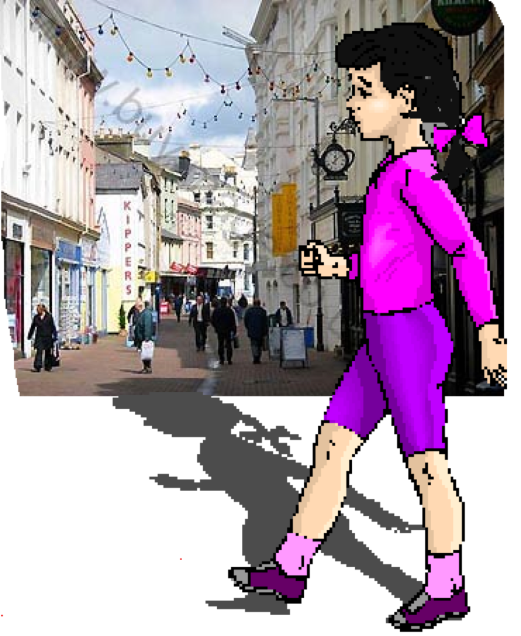
Ta Doona ayns Doolish Jedoonee,

Slide 5
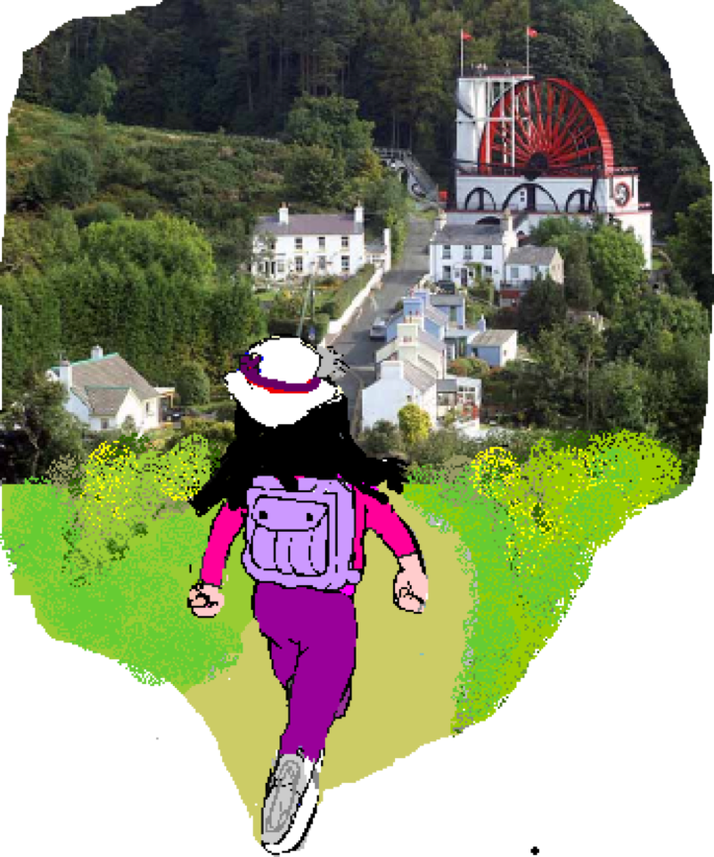
Ta Doona ayns Laksaa Jelune,

Slide 6
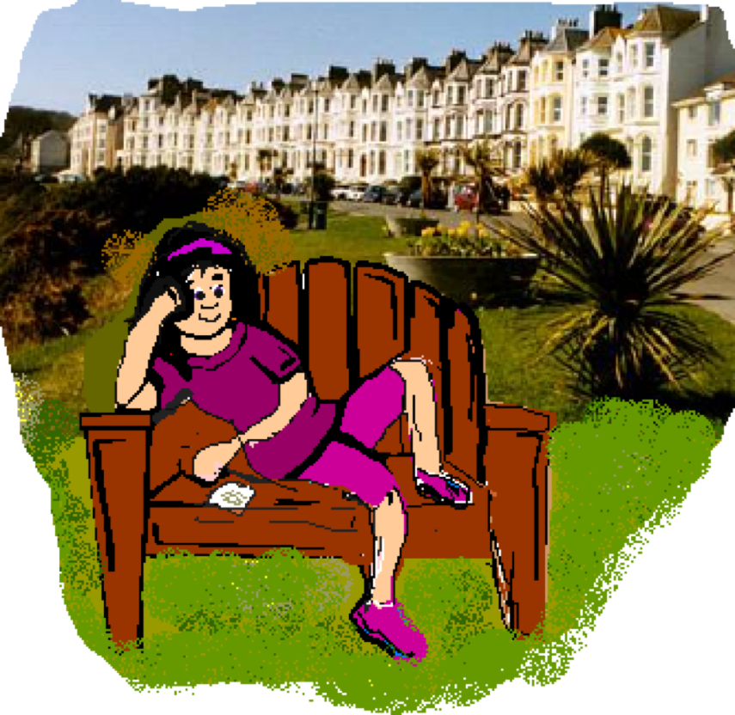
Ta Doona ayns Purt-le-Moirrey Jemayrt,

Slide 7
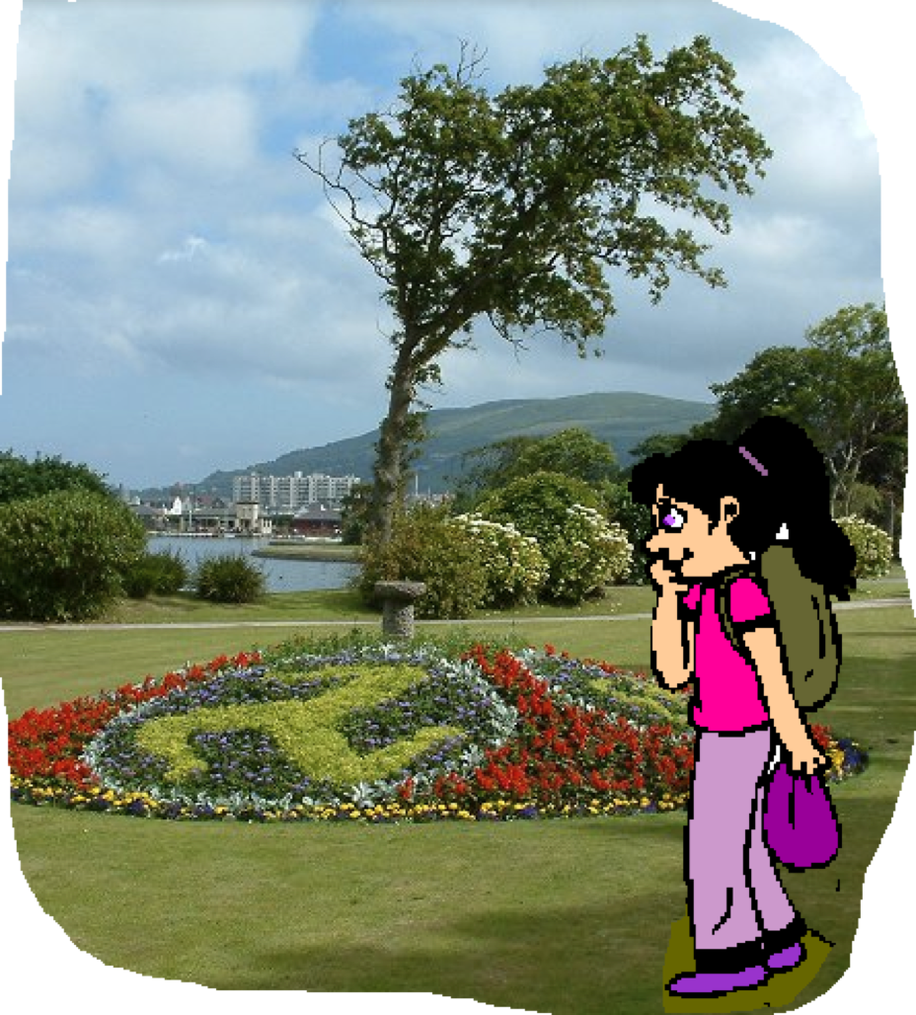
Ta Doona ayns Rhumsaa Jecrean,

Slide 8
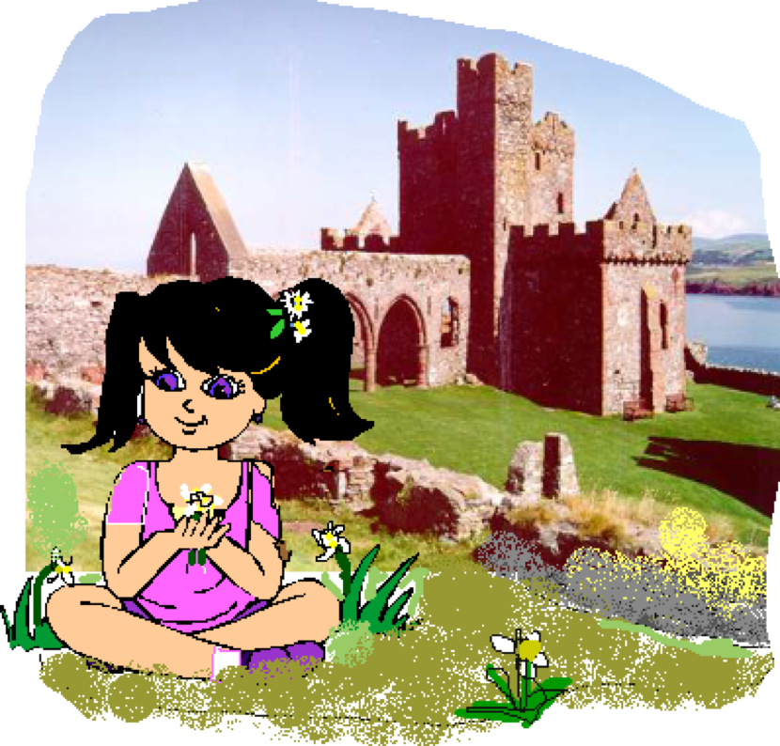
Ta Doona ayns Purt ny h-Inshey Jerdein,

Slide 9
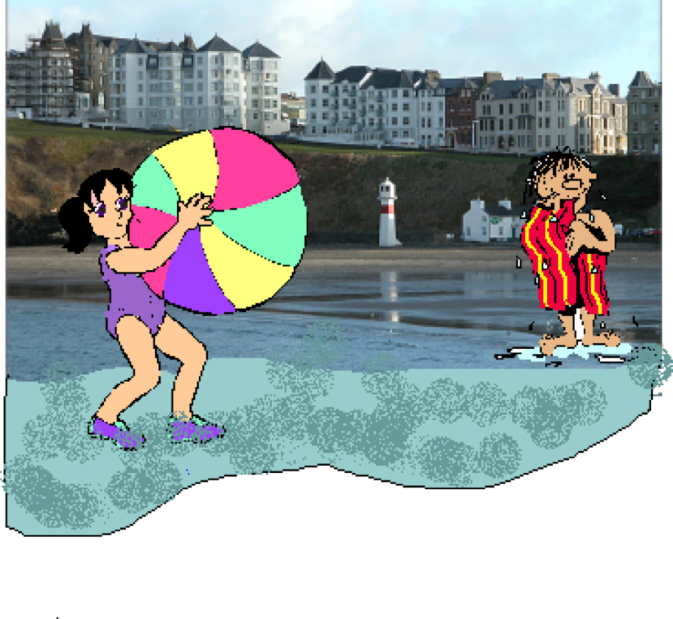
Ta Doona ayns
Purt Çhiarn Jeheiney

Slide 10
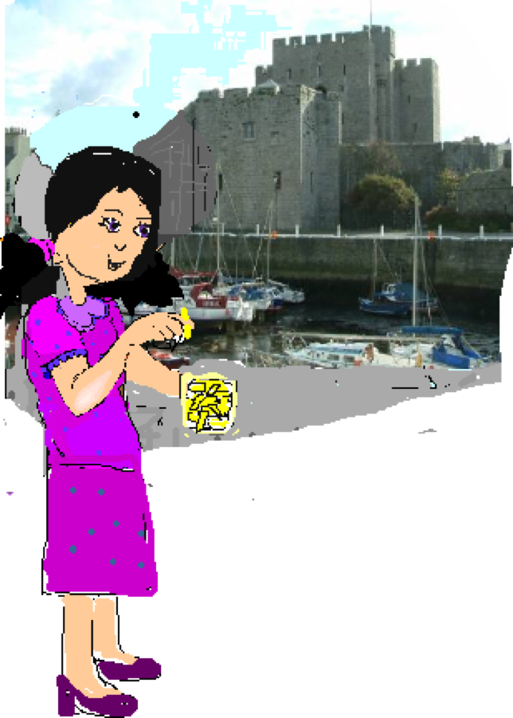
Ta Doona
ayns Balley Chashtal Jesarn

Slide 11
as cha nel laa er mayrn!

Slide 12
Shiaghtin ayns Ellan Vannin A week in the Isle of Man
Ta Doona ayns Doolish Jedoonee, Doona is in Douglas on Sunday,
Ta Doona ayns Laksaa Jelune, Doona is in Laxey on Monday,
Ta Doona ayns Purt-le-Moirrey Jemayrt, Doona is in
Port St. Mary on Tuesday,
Ta Doona ayns Rhumsaa Jecrean, Doona is in Ramsey
on Wednesday,
Ta Doona ayns Purt ny h-Inshey Jerdein, Doona is in Peel
on Thursday,
Ta Doona ayns Purt Çhiarn Jeheiney, Doona is in Port Erin
on Friday,
Ta Doona ayns Balley Chashtal Jesarn, Doona is in
Castletown on Saturday.
as cha nel laa er mayrn! and no days are left!

