Slide 1
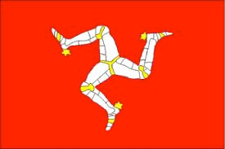
Gaelg
(You will need Powerpoint to play this game)
To play more Manx games online go to: https://oodlu.org/home
Ask your parent/guardian to sign you up & enter Group code 134n

Slide 2
Emshyr/Weather
Game
Click on the adjective you hear.

Slide 4
Shen eh!

Slide 6
Shen eh!

Slide 8
Shen eh!

Slide 10
Shen eh!

Slide 12
Shen eh!

Slide 13
T’eh bodjallagh as grianagh.
Cre gollrish t’an yn emshyr jiu?
T’eh grianagh.
T’eh bodjallagh.
T’eh sterrymagh.
as = and
T’eh ceau fliaghey.
T’eh ceau sniaghtey.
geayeeagh

Slide 14
x

