Slide 1
Bee as Jough
Food and Drink

Slide 2
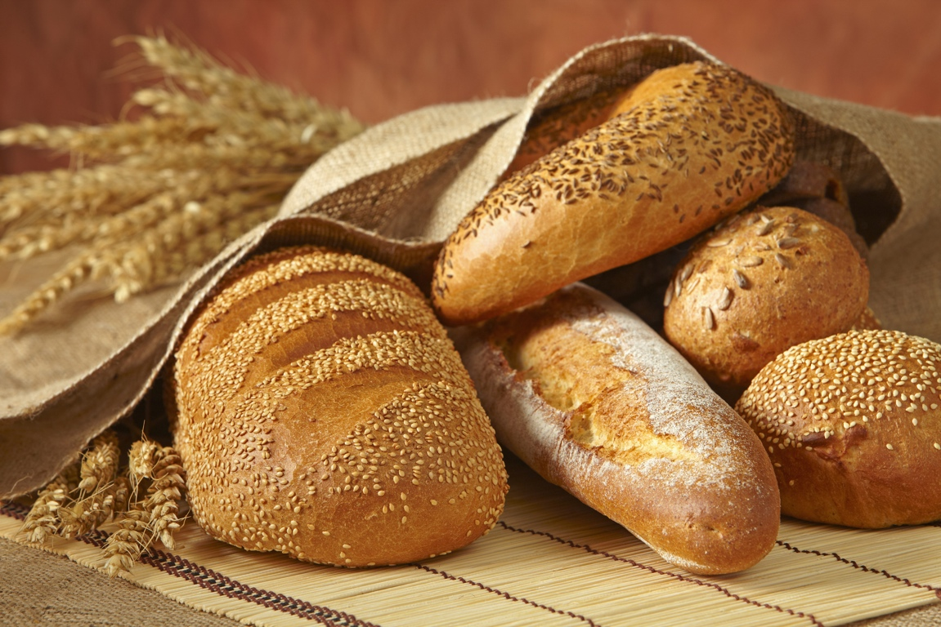
arran

Slide 3
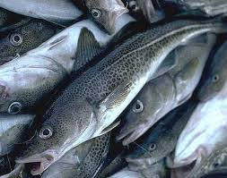
eeast

Slide 4
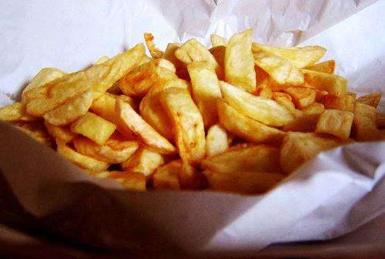
spollagyn

Slide 5
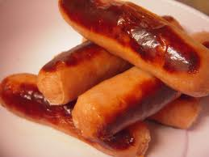
pronnagyn

Slide 6
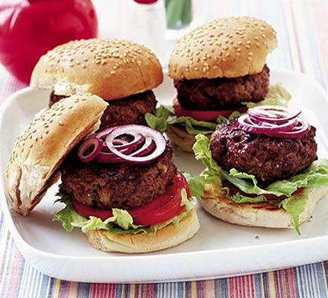
burgeyryn

Slide 7
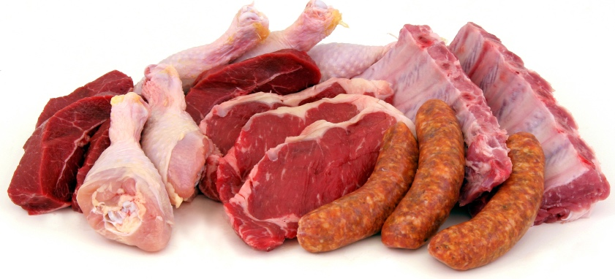
feill

Slide 8
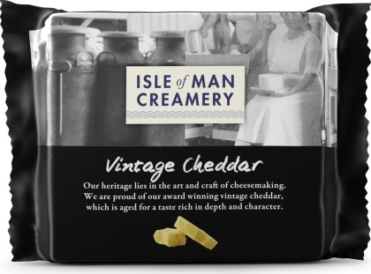
caashey

Slide 9
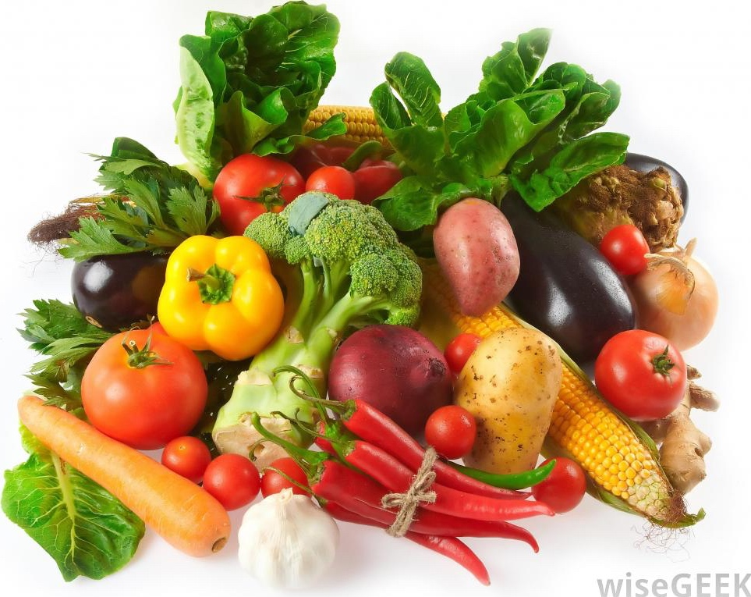
lossreeyn

Slide 10
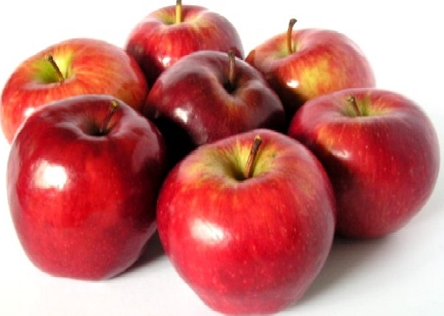
ooyllyn

Slide 11
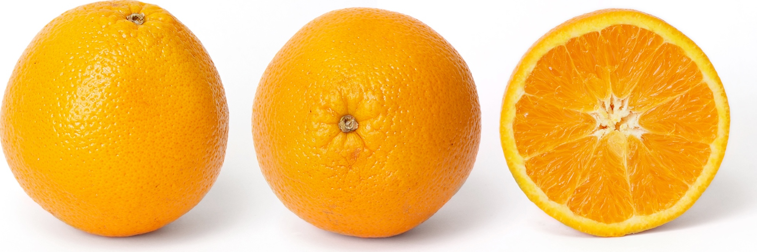
noiridyn

Slide 12
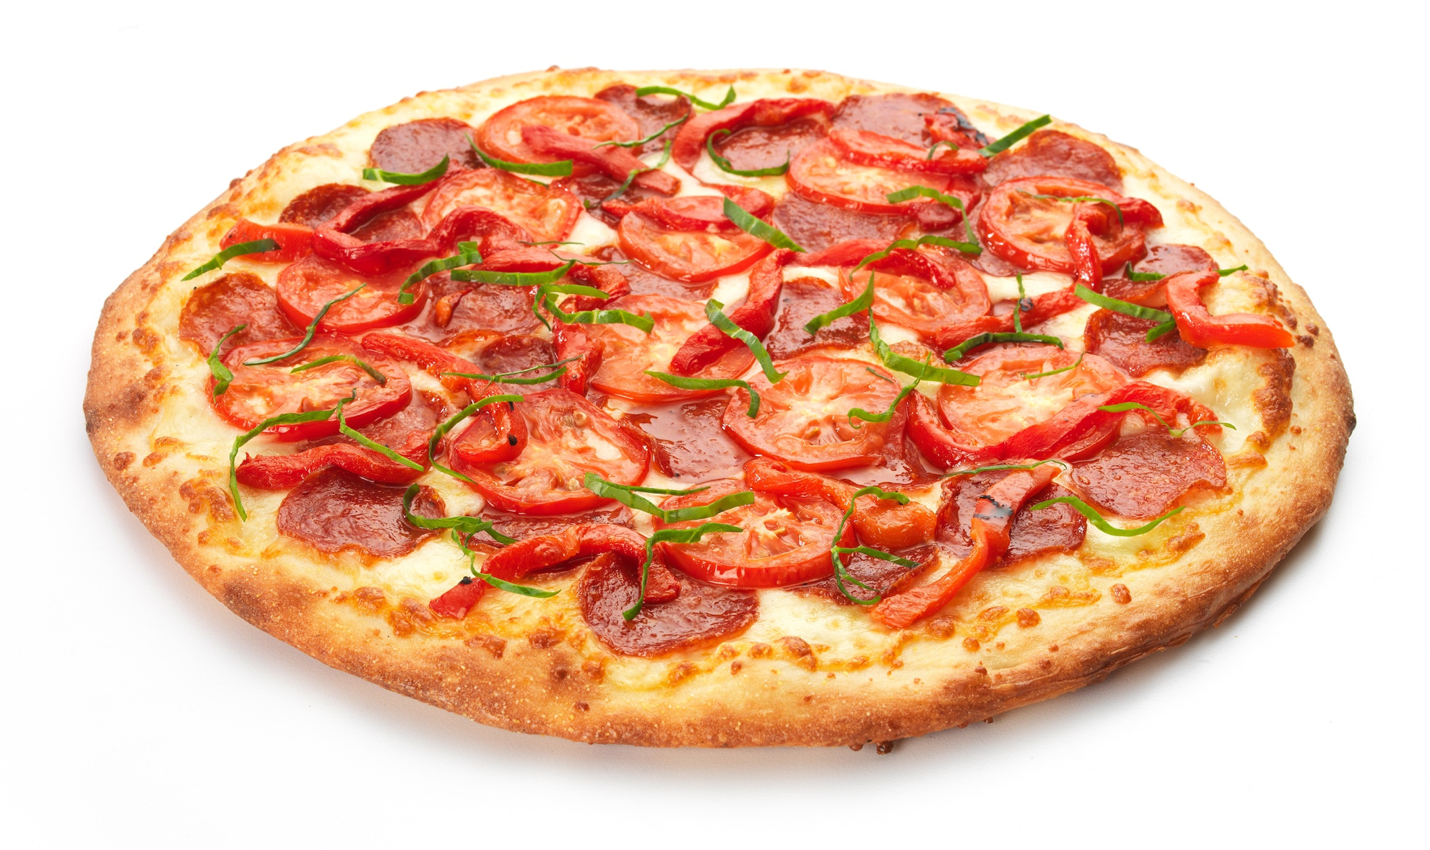
peetsey

Slide 13
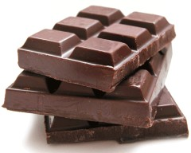
shocklaid

Slide 14
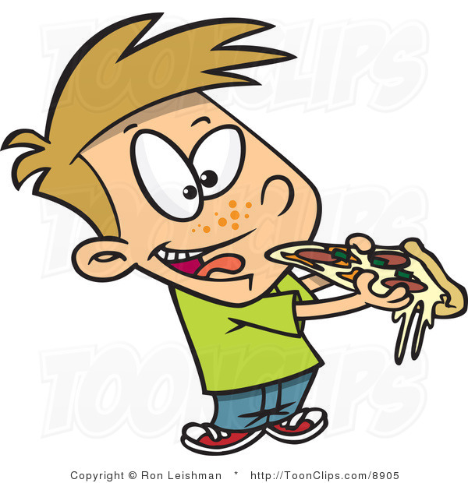
gee
eating

Slide 15
Ta mee gee peetsey
I am eating pizza

Slide 16
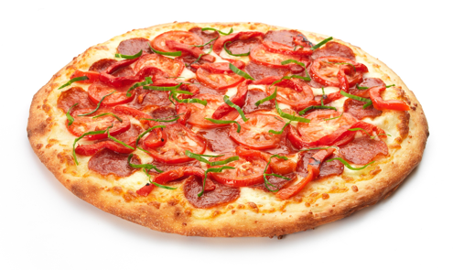
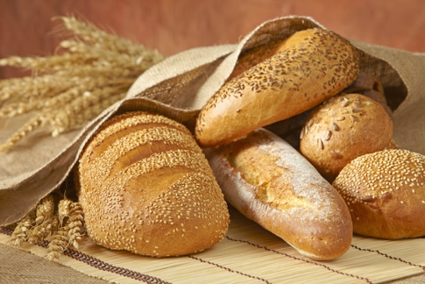
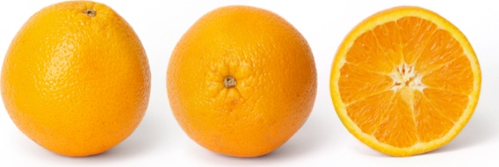
Cre t’ou gee? - Ta mee gee...
What are you eating? – I am eating …….
peetsey
burgeyryn
eeast
spollagyn
feill
lossreeyn
arran
caashey
ooyllyn
noiridyn
pronnagyn
shocklaid

Slide 17
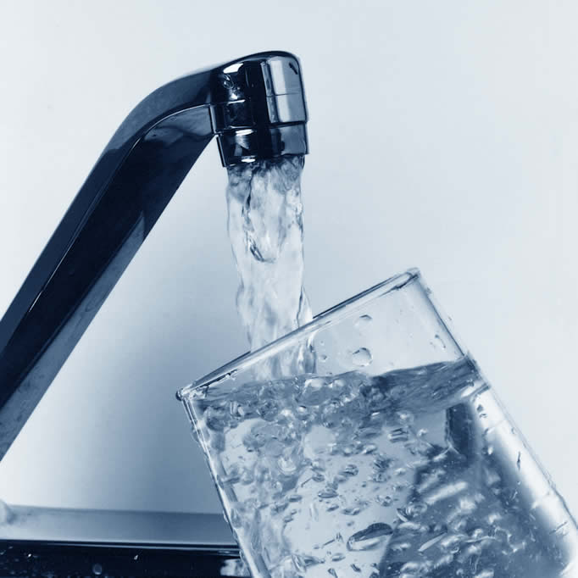
ushtey

Slide 18
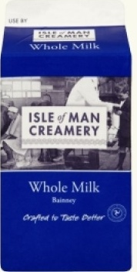
bainney

Slide 19
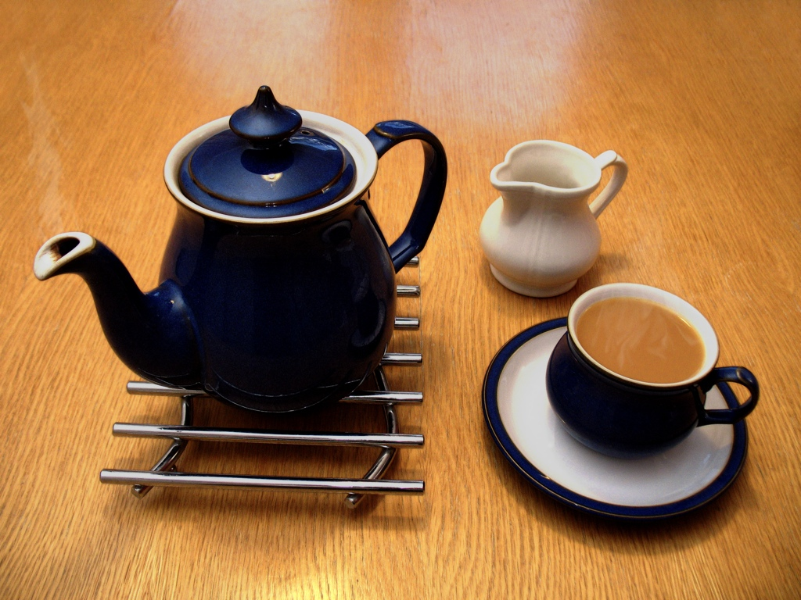
tey

Slide 20
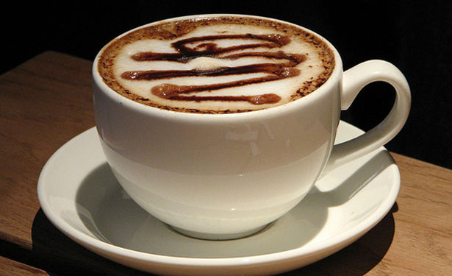
caffee

Slide 21
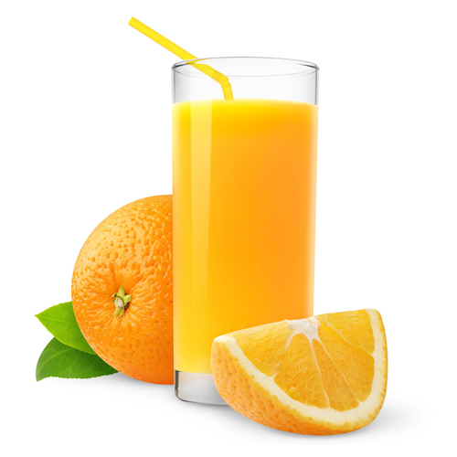
soo noirid

Slide 22
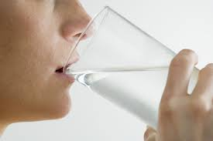
giu
drinking

Slide 23
Ta mee giu ushtey
I am drinking water

Slide 24
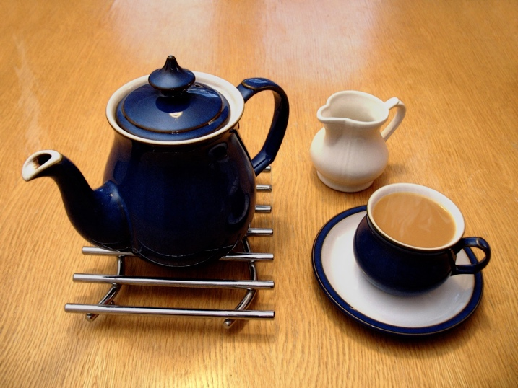
Cre t’ou giu? Ta mee giu ...
What are you drinking? I am drinking…..
ushtey
bainney
soo noirid
tey
caffee

Slide 25
Cre t’ou gee? Ta mee gee ...
Cre t’ou giu? Ta mee giu ...
peetsey
burgeyryn
shocklaid
ushtey
soo noirid
feill
eeast
spollagyn
tey
lossreeyn
ooyllyn
arran
caashey
bainney
noiridyn
pronnagyn
caffee

Slide 26
S’mie lhiam ushtey
S’mie lhiam ushtey,
S’mie lhiam soo.
Shoh my yough
as ta mee giu.
I like water,
I like juice.
This is my drink
and I am drinking.

