Slide 1
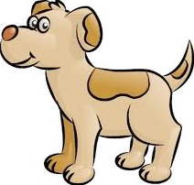
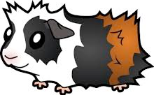
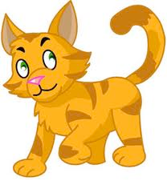
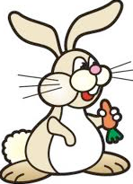
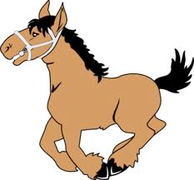
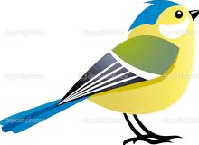
Bigginyn
(Pets)

Slide 2
moddey
dog

Slide 3
Vel biggin ayd?
(Do you have a pet?)

Slide 4
Ta moddey aym.
(I have a dog)

Slide 5
Cha nel moddey aym.
(I don’t have a dog)

Slide 6
kayt
(cat)

Slide 7
Vel biggin ayd?
(Do you have a pet?)

Slide 8
Ta kayt aym.
(I have a cat)

Slide 9
Cha nel kayt aym.
(I don’t have a cat)

Slide 10
eeast
(fish)

Slide 11
Vel biggin ayd?

Slide 12
Ta eeast aym.

Slide 13
Cha nel eeast aym.

Slide 14
conning
(rabbit)

Slide 15
Vel biggin ayd?

Slide 16
Ta conning aym.

Slide 17
Cha nel conning aym.

Slide 18
muc rangagh
(guinea pig)

Slide 19
Vel biggin ayd?

Slide 20
Ta muc rangagh aym.

Slide 21
Cha nel muc rangagh aym.

Slide 22
cabbyl

Slide 23
Vel biggin ayd?

Slide 24
Ta cabbyl aym.

Slide 25
Cha nel cabbyl aym.

Slide 26
muc rangagh
moddey
yn jerrey
kayt
(the end)
conning
ushag
cabbyl
eeast

