Slide 1
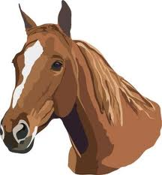
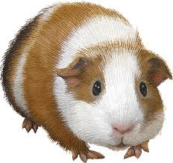
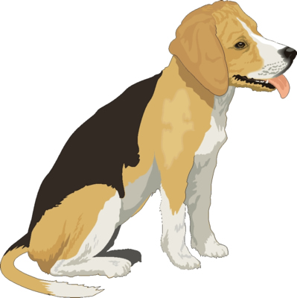
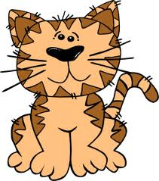
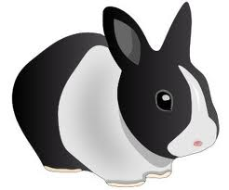
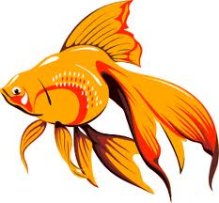
Bigginyn
Pets
Traa son gamman! Time for a game!
In this game, you can practise the words for pets which you learnt in PowerPoint 10.1 and 2 new ones. You can see them all on the next slide.

Slide 2
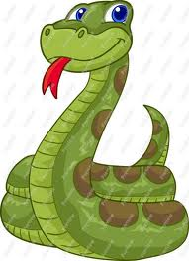
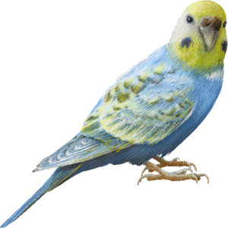
Bigginyn
moddey
kayt
eeast
conning
muc rangagh
cabbyl
ushag
ard-nieu
Play the PowerPoint slideshow when you’re ready to start the game

Slide 3
cabbyl

Slide 4
Shen eh!
(That’s it!)

Slide 5
muc rangagh

Slide 6
Shen eh!
(That’s it!)

Slide 7
conning

Slide 8
Shen eh!
(That’s it!)

Slide 9
moddey

Slide 10
Jeant dy mie!
(Well done!)

Slide 11
kayt

Slide 12
Jeant dy mie!
(Well done!)

Slide 13
ard-nieu

Slide 14
Feer vie!
(Very good!)

Slide 15
eeast

Slide 16
Feer vie!
(Very good!)

Slide 17
ushag

Slide 18
Yindyssagh!
(Wonderful! Brilliant!)

Slide 19
Jeant!
Finished!

