Slide 1
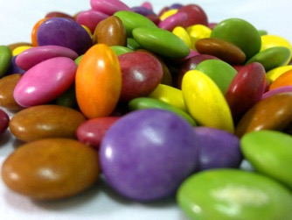
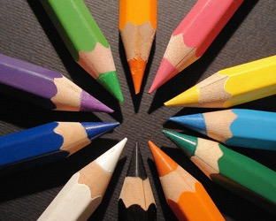
Daaghyn
Colours

Slide 2
gorrym
doo

Slide 3
bane

Slide 4
jiarg

Slide 5
bwee

Slide 6
gorrym

Slide 7
glass

Slide 8
dhone

Slide 9
lheeah

Slide 10
jiarg-bane

Slide 11
jiarg-bwee

Slide 12
jiarg-gorrym / gorrym-jiarg

Slide 13
doo
bane
glass
jiarg
bwee
gorrym
dhone
lheeah
jiarg-bane
gorrym-jiarg
jiarg-gorrym
jiarg-bwee

Slide 14
Cre’n daah ta shoh?
What colour is this?

Slide 15
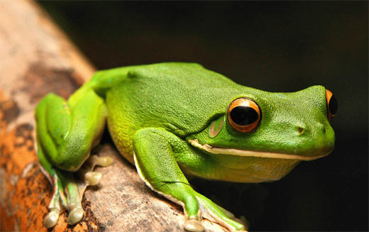

Slide 16
glass

Slide 17
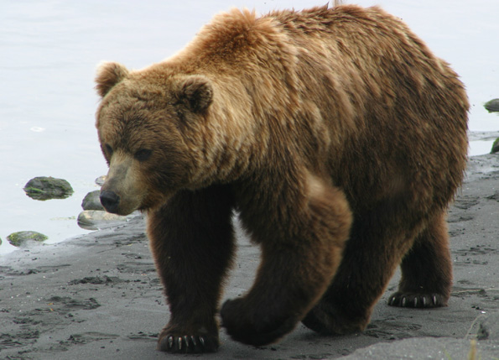

Slide 18
dhone

Slide 20
bane

Slide 21
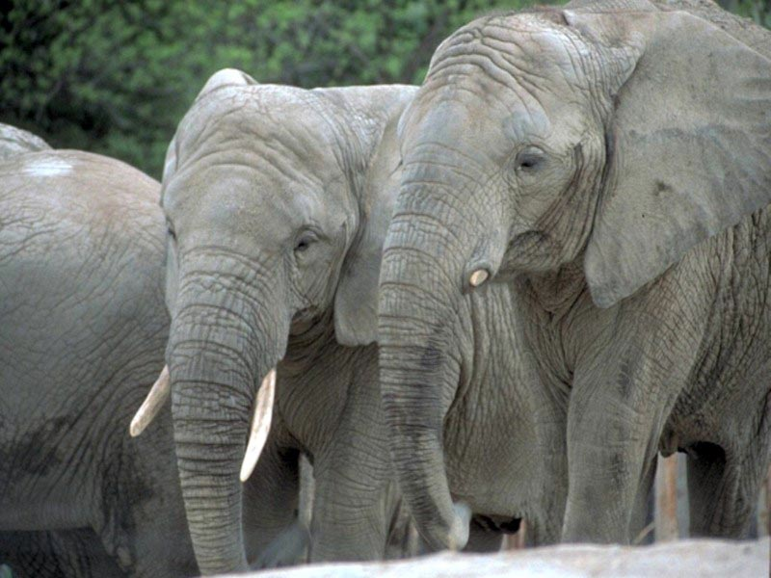

Slide 22
lheeah

Slide 24
gorrym

Slide 26
doo

Slide 27
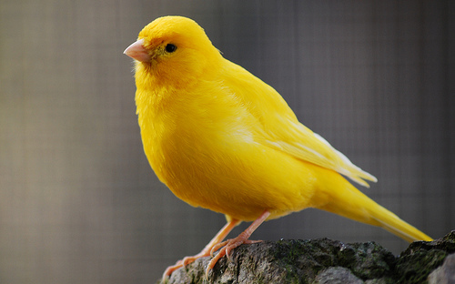

Slide 28
bwee

Slide 29
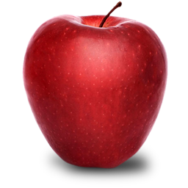

Slide 30
jiarg

Slide 32
jiarg-bwee

Slide 34
jiarg-bane

Slide 36
jiarg-gorrym /
gorrym-jiarg

Slide 37
Jeant!

