Slide 1
Arraghey (Transport)
In this game you can practise the words for different means of transport.
Click the picture that matches the sound / word.
Click to the next slide for a quick recap.

Slide 2
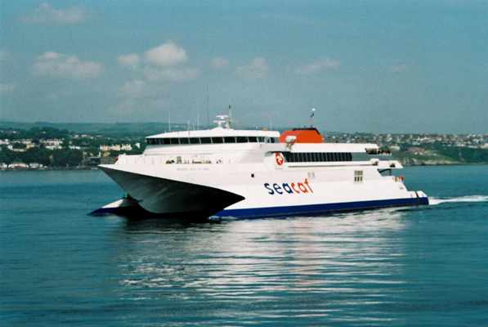
roar-bree
roar
barroose
traen
etlan
baatey
gleashtan
roggad
cabbyl
Click when you are ready to start the game.

Slide 3
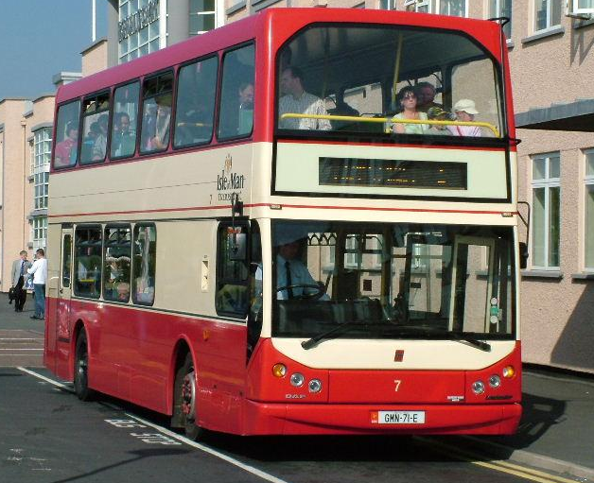
baatey

Slide 4
Shen eh!
(That’s it!)

Slide 5
gleashtan

Slide 6
Jeant dy mie!
(Well done!)

Slide 7
roar

Slide 8
Feer vie!
(Very good!)

Slide 9
barroose

Slide 10
Shen eh!
(That’s it!)

Slide 11
cabbyl

Slide 12
Jeant dy mie!
(Well done!)

Slide 13
traen

Slide 14
Feer vie!
(Very good!)

Slide 15
etlan

Slide 16
Shen eh!
(That’s it!)

Slide 17
roar-bree

Slide 18
Feer vie!
(Very good!)

Slide 19
roggad

Slide 20
Yindyssagh!
(Wonderful! Brilliant!)

Slide 21
jeant! Done!

