Slide 1
Arraghey
Transport

Slide 2
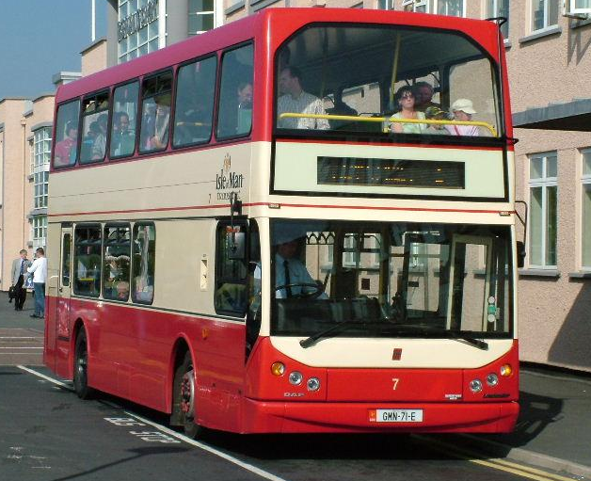
barroose (bus)

Slide 3
gleashtan (car)

Slide 4
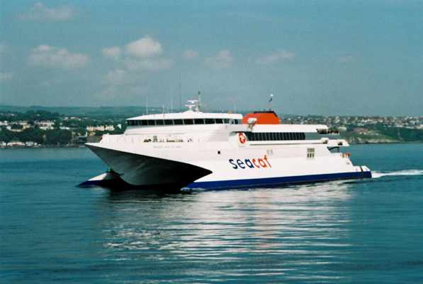
baatey (boat)

Slide 5
traen (train)

Slide 6
roar (bicycle)

Slide 7
roar-bree (motorbike)

Slide 8
etlan (aeroplane)

Slide 9
roggad (rocket)

Slide 10
cabbyl (horse)

Slide 11
jeant! (DonE!)
Jeant!
Done!
If you’d like some more practice,
have a go at the next game as well.
You need to click on the word that matches the number.
Click when you are ready to start the game.

Slide 12
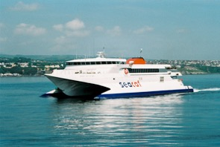
roar-bree
barroose
roar
traen
baatey
etlan
gleashtan
roggad
cabbyl

Slide 13
goll
(going)

Slide 14
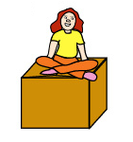
er
(on)

Slide 15
Ta mee
er
Ta mee goll er roar. (I’m going on a bicycle.)

Slide 16
Can you say this sentence?
Ta mee
Ta mee goll er traen. (I’m going on a train.)

Slide 17
Have a go at saying this one:
Ta mee
Ta mee goll er etlan. (I’m going on a plane.)

Slide 18
Now try to say these sentences:
Ta mee
Ta mee
Ta mee

Slide 19
Jeant dy mie!
(Well done!)

Slide 20
ayns
(in)

Slide 21
Ta mee
ayns
Ta mee goll ayns roggad. (I’m going in a rocket.)

Slide 22
Have a go at saying these sentences:
Ta mee
Ta mee goll ayns baatey. (I’m going in a boat.)
Ta mee
Ta mee goll ayns gleashtan. (I’m going in a car.)

Slide 23
Feer vie!
(Very good!)

Slide 24
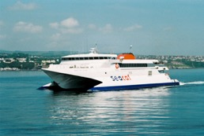
Ta mee goll…
er
roar-bree
barroose
roar
traen
etlan
cabbyl
baatey
ayns
gleashtan
roggad
baatey

Slide 25
dys
(to)

Slide 26
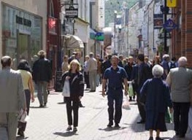
Ta mee
dys
Doolish
Ta mee goll dys Doolish. (I’m going to Douglas.)

Slide 27
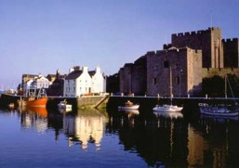
C’raad t’ou goll? (Where are you going?)
Can you answer the question with this sentence?
Ta mee
Balley Chashtal
Ta mee goll dys Balley Chashtal.
(I’m going to Castletown.)

Slide 28
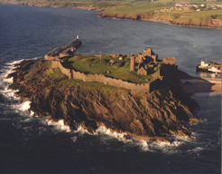
C’raad t’ou goll? (Where are you going?)
Can you answer the question with this sentence?
Ta mee
Purt ny h-Inshey
Ta mee goll dys Purt ny h-Inshey.
(I’m going to Peel.)

Slide 29
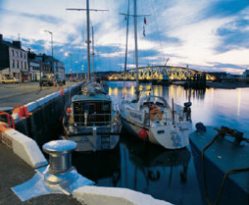
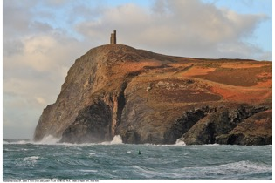
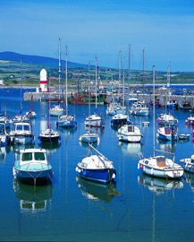
C’raad t’ou goll? (Where are you going?)
Ta mee
dys
Rhumsaa
Ta mee
Purt Çhiarn
Ta mee
Purt le Moirrey

Slide 30
Feer vie!
(Very good!)

Slide 31
Challenge Time!!!
Let’s try and put it all together:
Say where you are going and how!
Ta mee
dys
er
Ta mee goll dys Balley Chashtal er barroose.
(I’m going to Castletown on a bus.)

Slide 32
Can you say this sentence?
Ta mee
dys
ayns
Ta mee goll dys Purt Çhiarn ayns gleashtan.
(I’m going to Port Erin in a car.)

Slide 33
Now have a go at saying these sentences:
Ta mee
Ta mee goll dys Doolish er roar-bree.
(I’m going to Douglas on a motorbike.)
Ta mee
Ta mee goll dys Rhumsaa ayns baatey.
(I’m going to Ramsey in a boat.)
??? Can you make up some more sentences?
Say where you’re going today and how! ☺

Slide 34
Yindyssagh!
(Wonderful! Brilliant!)

Slide 35
Traa son arrane! (Time for a song!)
Ta mee gimman ayns my ghleashtan
(I am driving in my car)
Ta mee gimman ayns my ghleashtan - beep, beep, beep.
Ta mee gimman ayns my ghleashtan - beep, beep, beep.
Ta mee gimman ayns my ghleashtan, gimman ayns my ghleashtan,
gimman ayns my ghleashtan - beep, beep, beep.
Ta mee gimman feer tappee - beep, beep, beep.
Ta mee gimman feer tappee - beep, beep, beep.
Ta mee gimman feer tappee, gimman feer tappee,
gimman feer tappee - beep, beep, beep.
Ta mee gimman feer voal - beep, beep, beep.
Ta mee gimman feer voal - beep, beep, beep.
Ta mee gimman feer voal, gimman feer voal,
gimman feer voal - beep, beep, beep.
Ta mee gimman ayns my ghleashtan - beep, beep, beep. …
------------------------------------------------------------------------
Ta mee gimman – I am driving feer tappee – very fast feer voal – very slowly

Slide 36
jeant! (DonE!)
For more practice, have a go at the Power Point game and try filling in the worksheet. ☺

