Slide 1
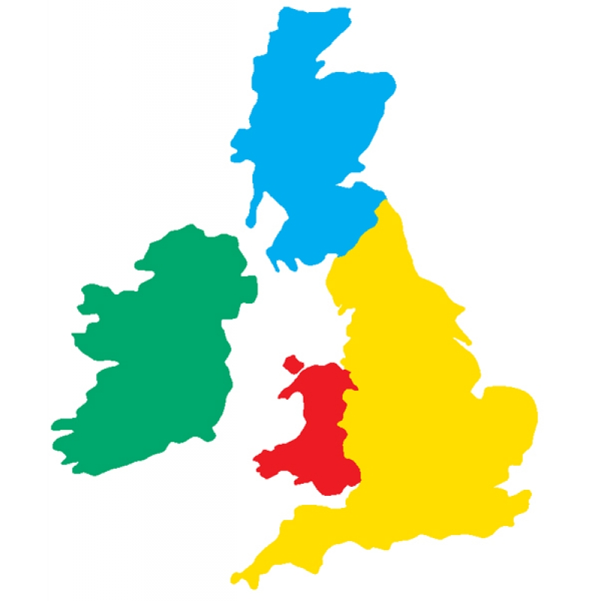
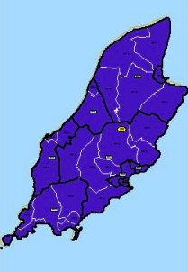
Ny h-Ellanyn Goaldagh (The British Isles) In this game you can practise the countries you learnt in the Power Point presentation. Click the picture that matches the country.

Slide 2
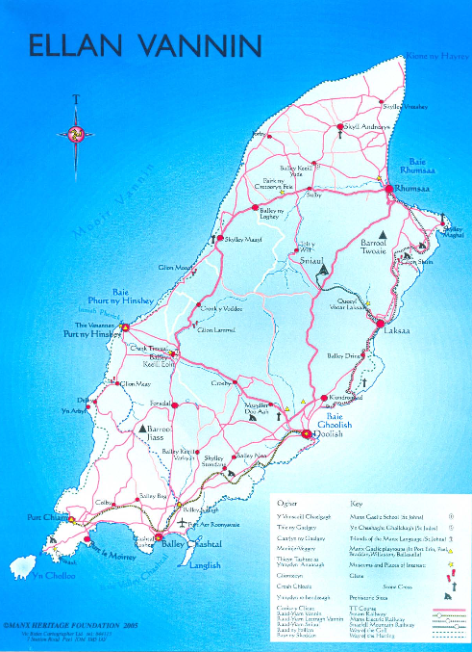
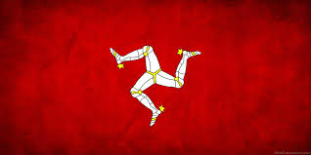
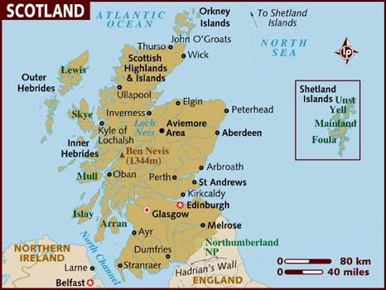
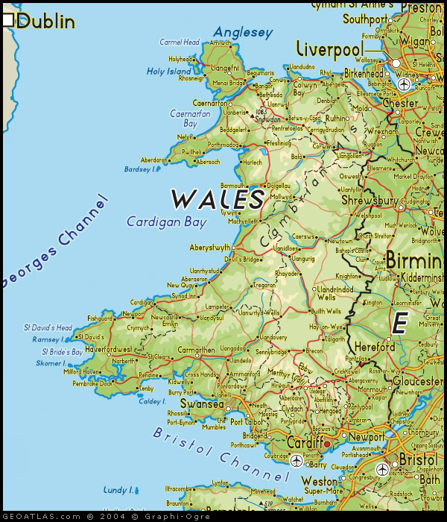
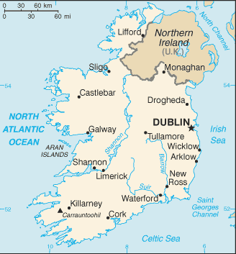
Mannin

Slide 3
Jeant dy mie!
(Well done!)

Slide 4
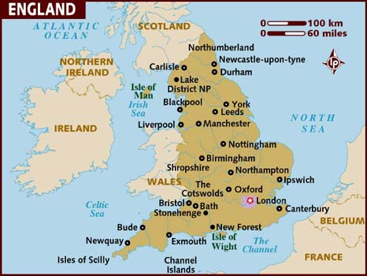
Nerin Twoaie

Slide 5
Jeant dy mie!
(Well done!)

Slide 6
Nalbin

Slide 7
Jeant dy mie!
(Well done!)

Slide 8
Sostyn

Slide 9
Feer vie!
(Very good!)

Slide 10
Bretin

Slide 11
Feer vie!
(Very good!)

Slide 12
Nerin

Slide 13
Feer vie!
(Very good!)

Slide 14
jeant! (Done!)

Slide 15
Ny h-Ellanyn Goaldagh
Mannin / Ellan Vannin
Sostyn
Nalbin
Bretin
Nerin
Nerin Twoaie

