Slide 1
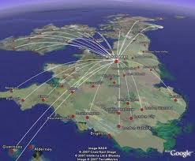
Ny h-Ellanyn Goaldagh

Slide 2
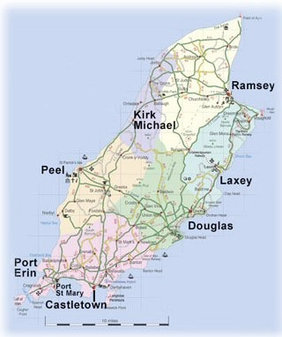
Mannin

Slide 3
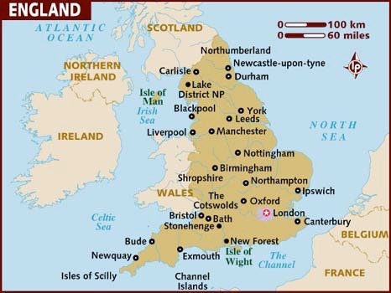
Sostyn

Slide 4
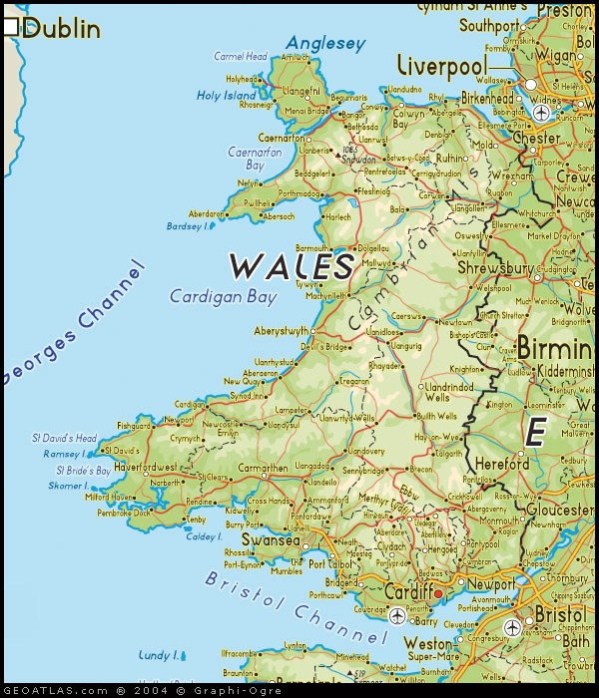
Bretin

Slide 5
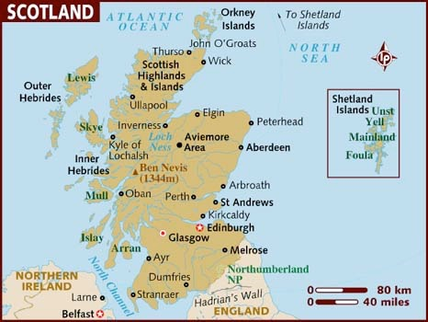
Nalbin

Slide 6
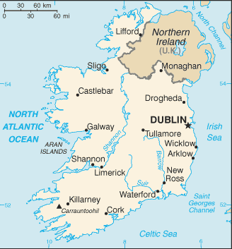
Nerin

Slide 7
Nerin Twoaie

Slide 8
Ren mee goll dys Mannin.
(I went to the Isle of Man.)

Slide 9
Sostyn
Ren mee goll dys Sostyn.
(I went to England.)

Slide 10
Bretin
Ren mee goll dys Bretin.
(I went to Wales.)

Slide 11
Nalbin
Ren mee goll dys Nalbin.
(I went to Scotland.)

Slide 12
Nerin
Ren mee goll dys Nerin.
(I went to Ireland.)

Slide 13
Nerin Twoaie
Ren mee goll dys Nerin Twoaie.
(I went to Northern Ireland.)

Slide 14
Cha ren mee goll dys Mannin.
(I didn’t go to the Isle of Man.)

Slide 15
Sostyn
Cha ren mee goll dys Sostyn.
(I didn’t go to England.)

Slide 16
Bretin
Cha ren mee goll dys Bretin.
(I didn’t go to Wales.)

Slide 17
Nalbin
Cha ren mee goll dys Nalbin.
(I didn’t go to Scotland.)

Slide 18
Nerin
Cha ren mee goll dys Nerin.
(I didn’t go to Northern Ireland.)

Slide 19
Nerin Twoaie
Cha ren mee goll dys Nerin Twoaie.
(I didn’t go to Northern Ireland.)

Slide 20
Northern Ireland
England
Isle of Man

Slide 21
Nerin Twoaie
Sostyn
Northern Ireland
Nerin
Mannin
England
Nalbin
Bretin
Isle of Man

Slide 22
C’raad ren oo goll? Where did you go?
Mannin
Nalbin
Nerin
Twoaie
Sostyn
Nerin
Bretin
Ren mee goll dys……
Cha ren mee goll dys…..

