Slide 1
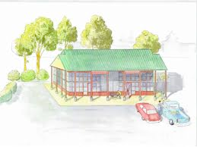
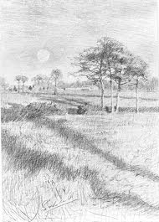
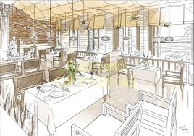
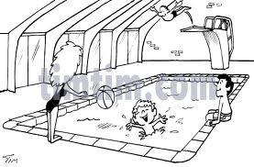
Balley as çheer
(Town and country)
Click to continue
To play the game,
you will need to open this presentation in Powerpoint

Slide 2
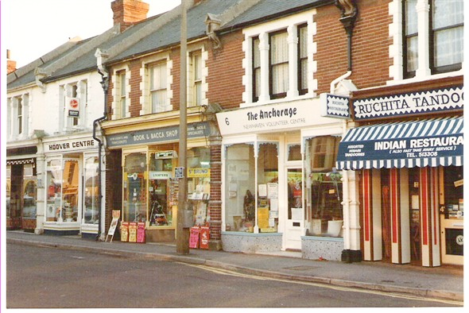

Slide 3
shappyn

Slide 5
scoill

Slide 7
pairk

Slide 8
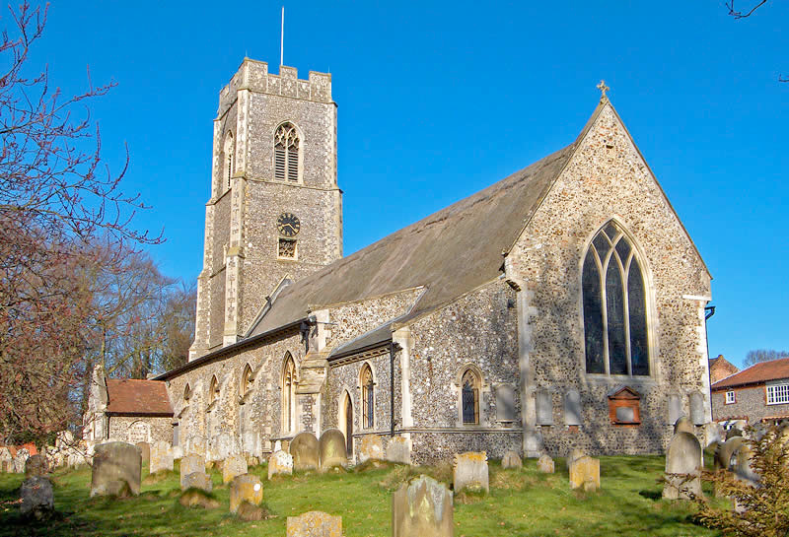

Slide 9
keeill

Slide 11
magher

Slide 12
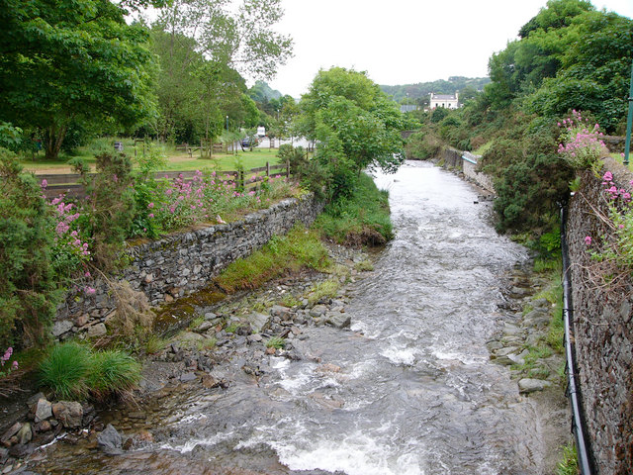

Slide 13
awin

Slide 14
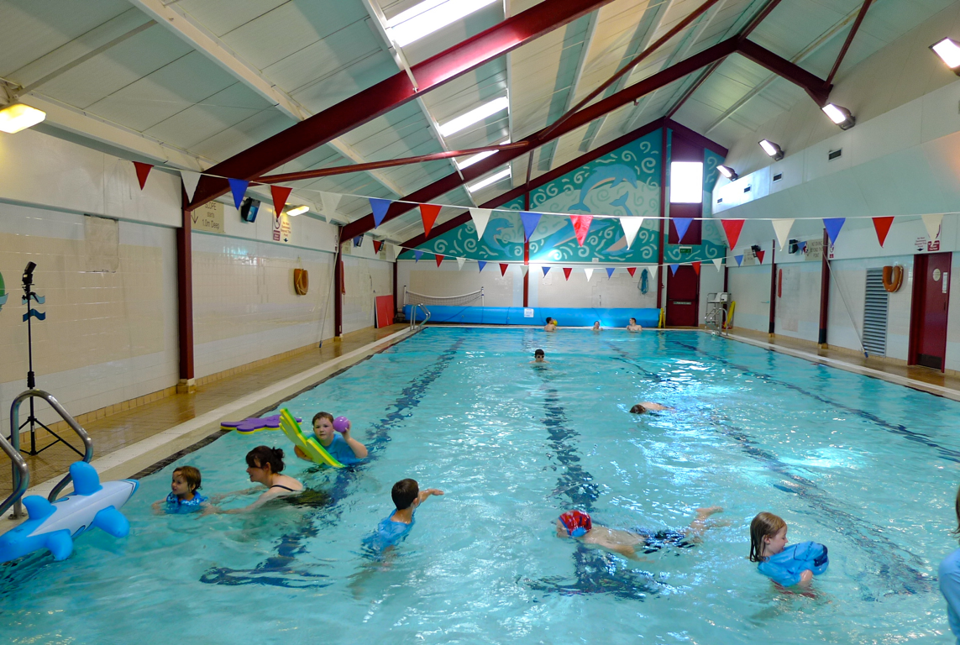

Slide 15
loghan snaue

Slide 17
thie bee

Slide 19
gowaltys

Slide 21
traie

Slide 22
Jeant!
Done!

Slide 23
keeill
Click the
correct picture
a)
b)
c)
d)

Slide 25
thie bee
a)
b)
c)
d)

Slide 27
gowaltys
a)
b)
c)
d)

Slide 29
scoill
a)
b)
c)
d)

Slide 31
traie
a)
b)
c)
d)

Slide 33
pairk
a)
b)
c)
d)

Slide 35
shappyn
a)
b)
c)
d)

Slide 37
loghan snaue
a)
b)
c)
d)

Slide 39
awin
a)
b)
c)
d)

Slide 41
magher
a)
b)
c)
d)

Slide 43
Jeant!
Done!

Slide 44
shappyn
traie
awin
keeill
loghan snaue
thie bee
gowaltys
magher
pairk

Slide 45
x

