Slide 1
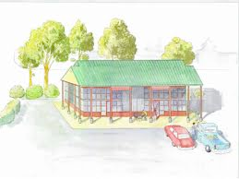
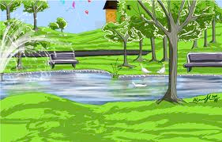
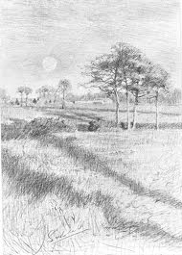
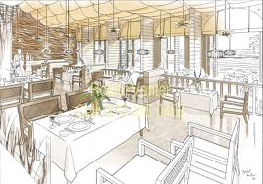
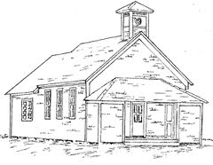
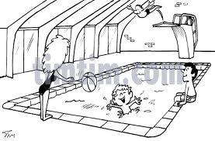
Balley as çheer
(Town and country)
Repeat the Manx you hear on each
of the following slides.

Slide 2
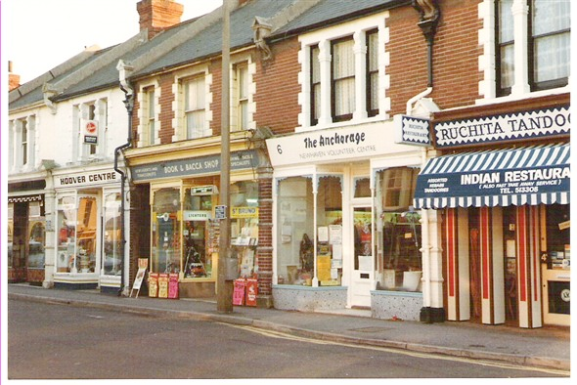
Vel oo cummal faggys da shappyn?

Slide 3
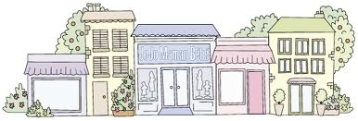
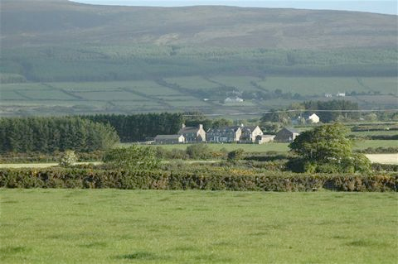
Ta mee cummal faggys da
shappyn.
Cha nel mee cummal faggys
da shappyn.

Slide 4
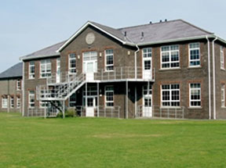
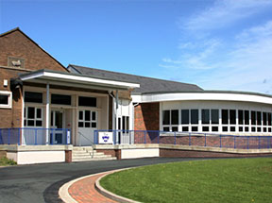
Vel oo cummal faggys da
scoill?

Slide 5
Cha nel mee cummal
faggys da scoill.
Ta mee cummal faggys da
scoill.

Slide 6
Vel oo cummal faggys da
pairk?

Slide 7
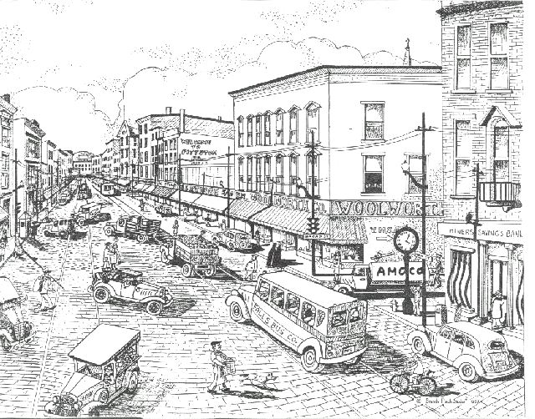
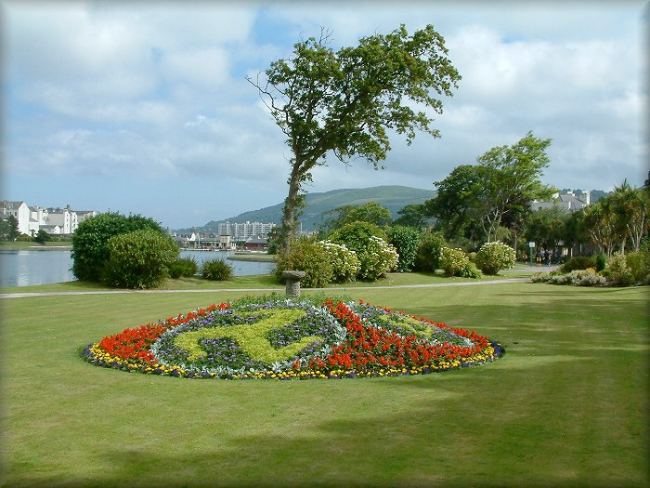
Cha nel mee cummal faggys
da pairk.
Ta mee cummal faggys da
pairk.

Slide 8
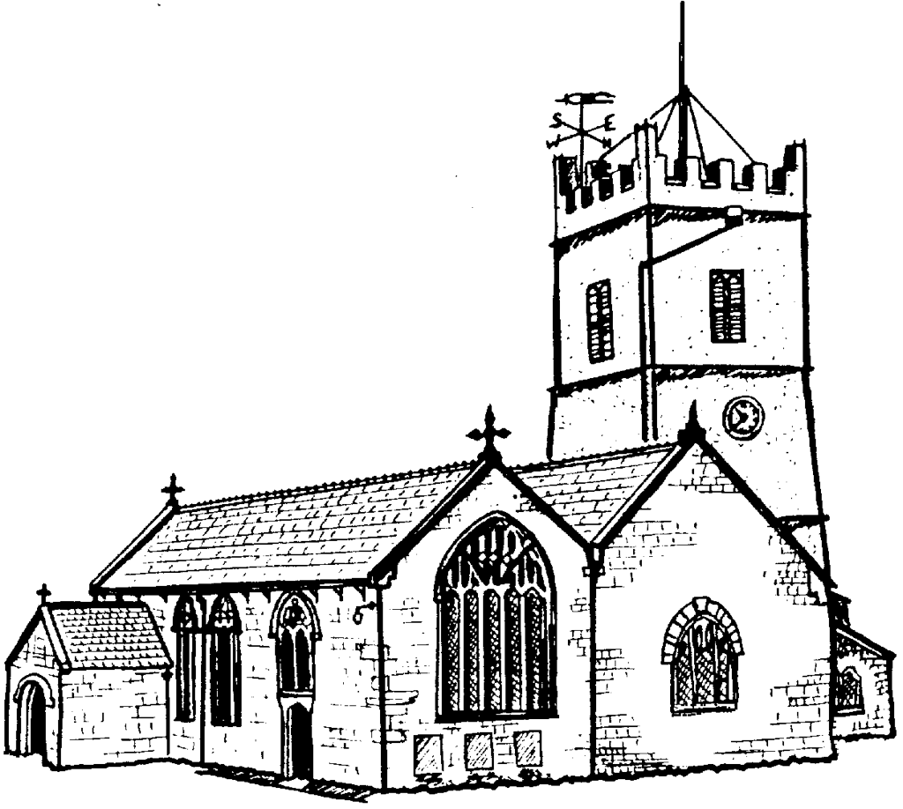
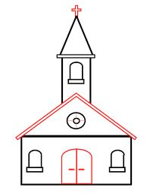
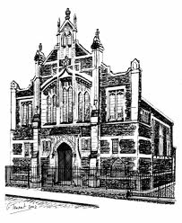
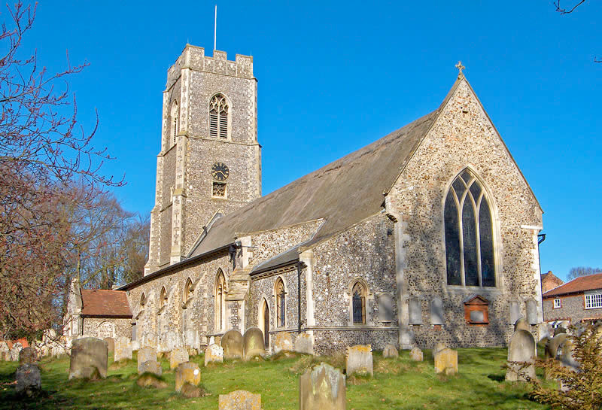
Vel oo cummal faggys da keeill?

Slide 9
Vel oo cummal faggys da
magher?

Slide 10
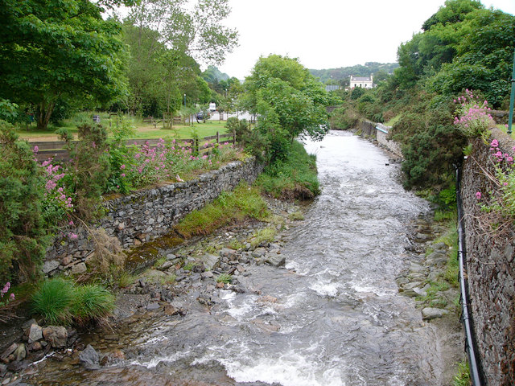
Vel oo cummal faggys da
awin?

Slide 11
Ta mee cummal faggys da…/Cha nel mee cummal faggys da…
‘sy valley | ‘sy çheer
shappyn | shops | magheryn | fields
scoill | a school | awin | a river
pairk | a park | gowaltys | a farm
keeill | a church | cronk | a hill
thie bee | a restaurant | y clieau | the mountain
loghan snaue | a swimming pool | biljyn | trees
thie lheihys | a hospital | keyll | a wood
stashoon meoir shee | a police station | logh | a lake
oik postagh | a post office | traie | a beach
lioarlan | library | eayninyn | cliffs

