Slide 1
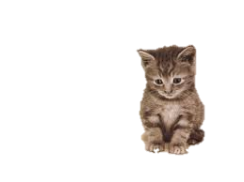
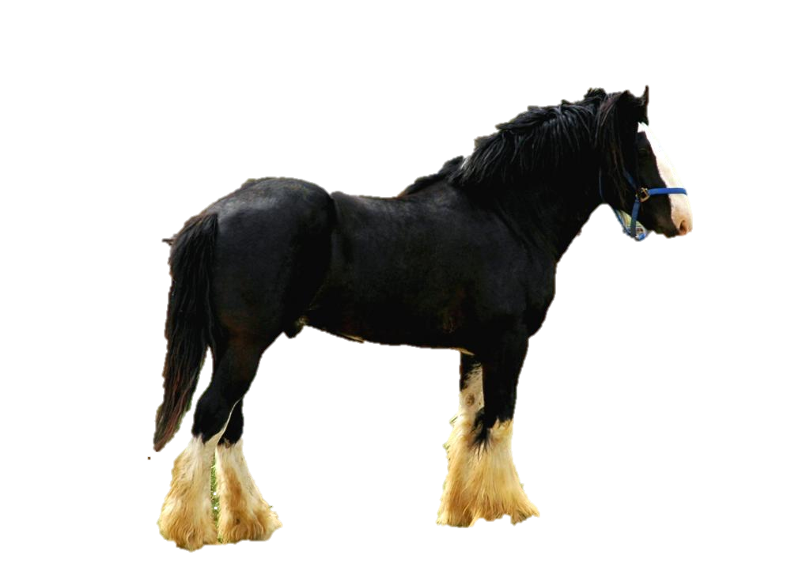
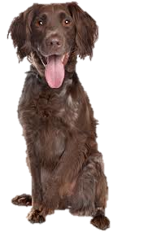
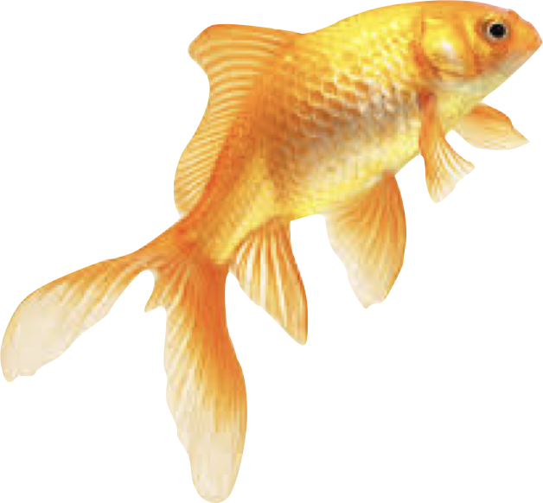
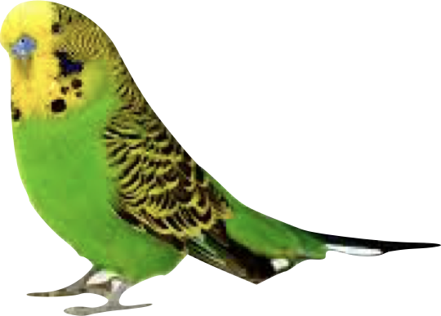
Describing pets
In this game you can practise some describing words and pets.
Click the picture that matches the sound / words.

Slide 2
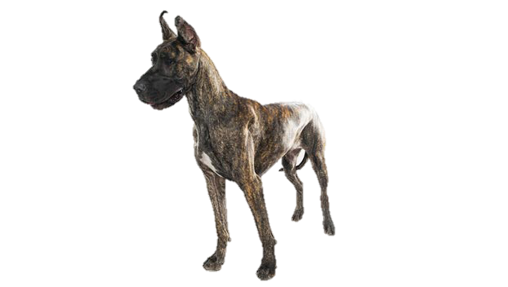
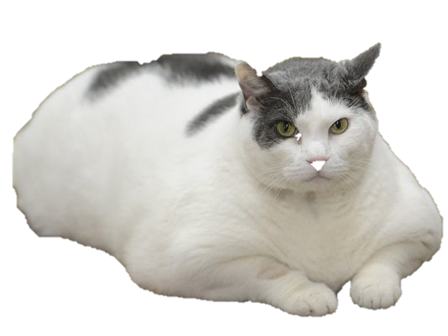
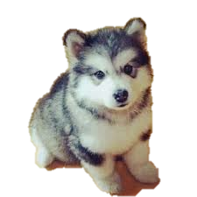
moddey mooar

Slide 3
Shen eh!
(That’s it!)

Slide 4
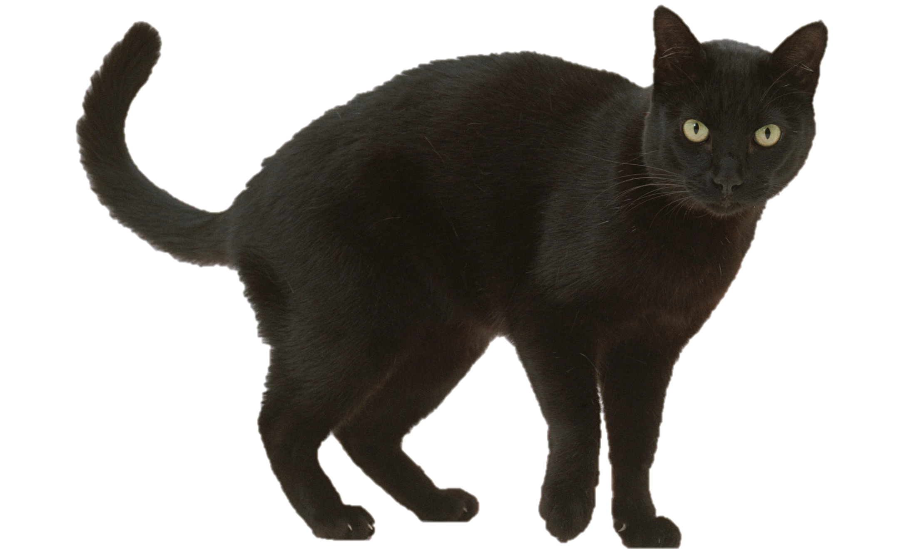
kayt doo

Slide 5
Shen eh!
(That’s it!)

Slide 6
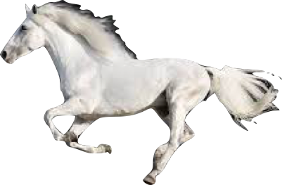
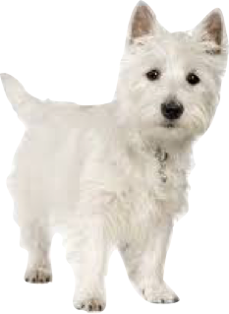
cabbyl bane

Slide 7
Shen eh!
(That’s it!)

Slide 8
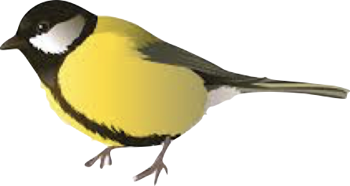
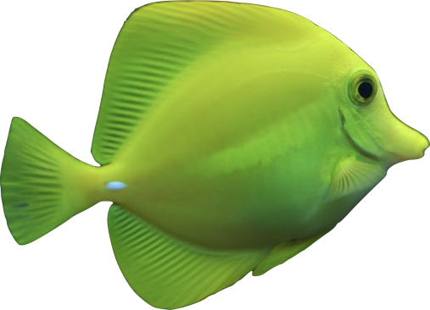
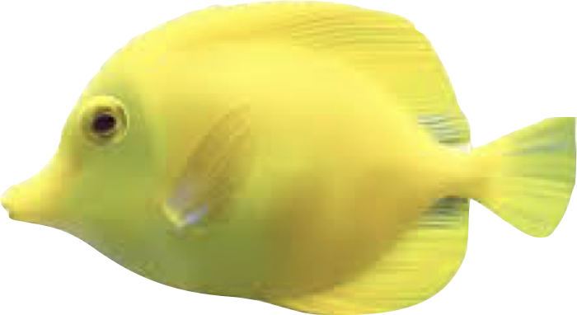
eeast bwee

Slide 9
Shen eh!
(That’s it!)

Slide 10
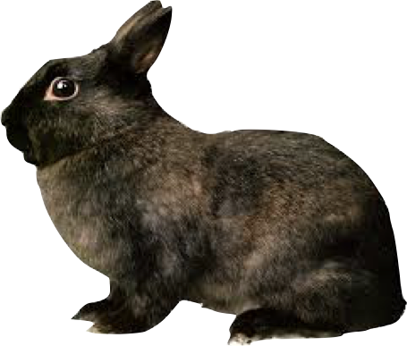
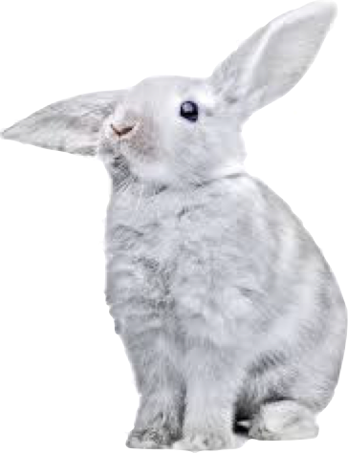
conning vane

Slide 11
Shen eh!
(That’s it!)

Slide 12
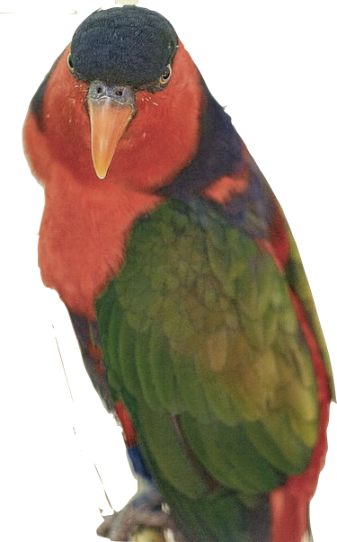
ushag veg

Slide 13
Shen eh!
(That’s it!)

Slide 14
moddey beg bane as lheeah

Slide 15
Shen eh!
(That’s it!)

Slide 16
kayt mooar bane as lheeah

Slide 17
Shen eh!
(That’s it!)

Slide 18
cabbyl mooar as bane

Slide 19
Shen eh!
(That’s it!)

Slide 20
ushag ghoo as bwee

Slide 21
Shen eh!
(That’s it!)

