Slide 1
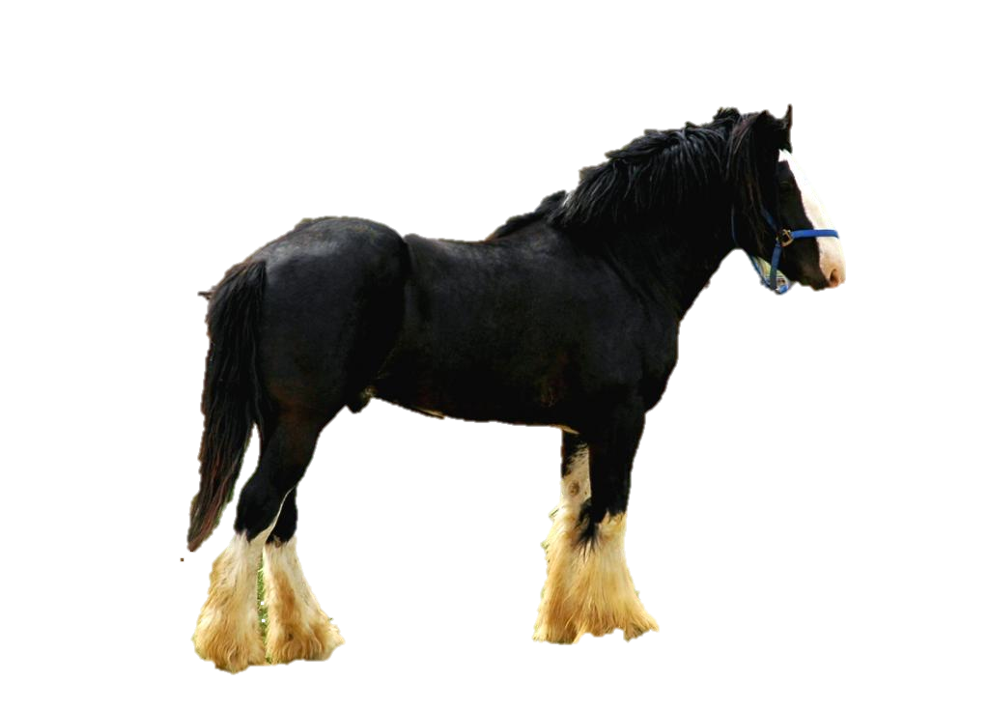
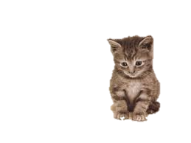
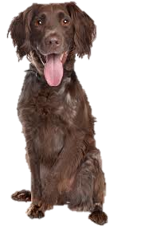
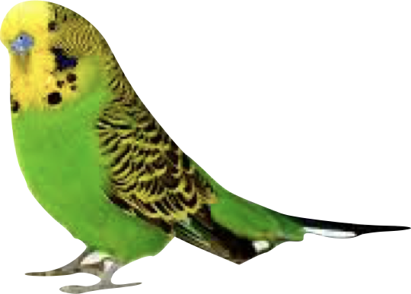
Describing pets

Slide 2
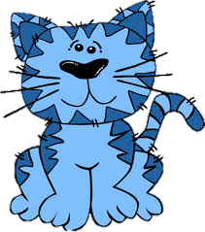
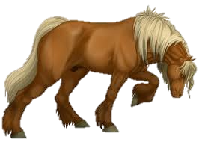
An adjective is a describing word.
eg.
A blue cat
A big horse

Slide 3
You know some already
dhone
jiarg
doo
bwee
jiarg-bane
jiarg-bwee
lheeah
bane
Jiarg-
gorrym
airhey
gorrym
glass

Slide 4
Mooar as beg
(Big and small)
Mooar
(big)
Beg
(small)

Slide 5
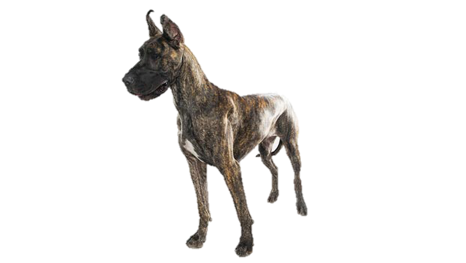
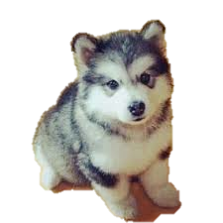
Moddey
(Dog)
moddey dhone
(a brown dog)
moddey mooar
(a big dog)
moddey beg
(a small dog)

Slide 6
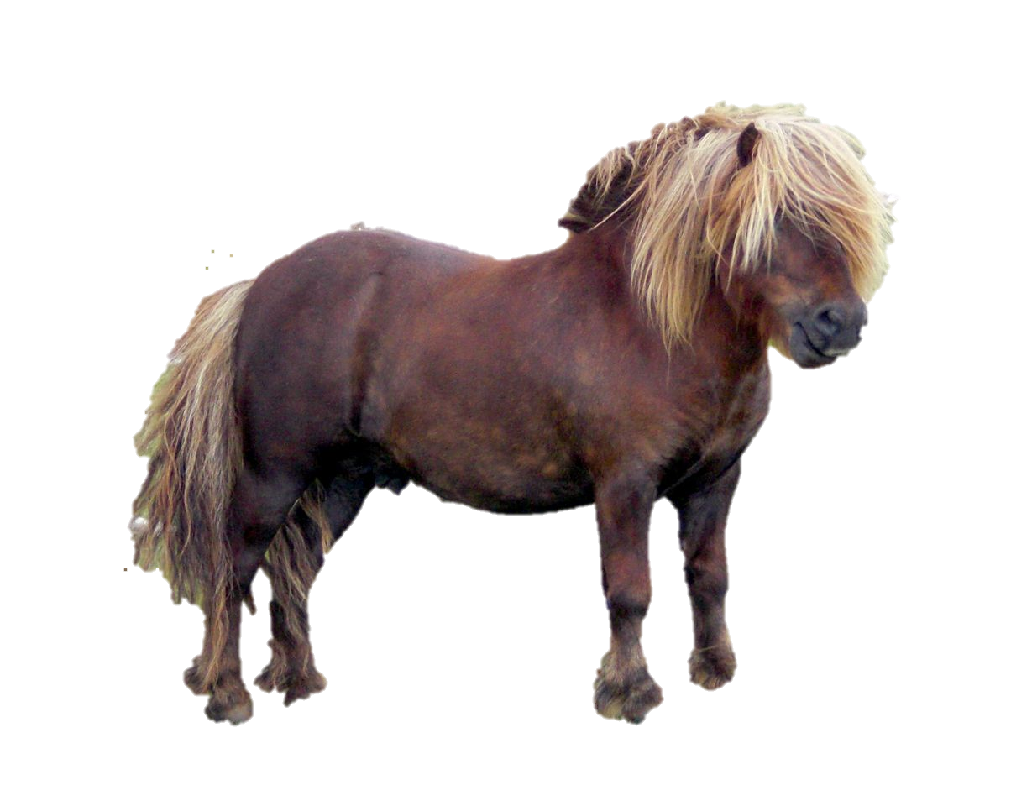
cabbyl
(horse)
cabbyl mooar
(a big horse)
cabbyl beg dhone
(a small brown horse)

Slide 7
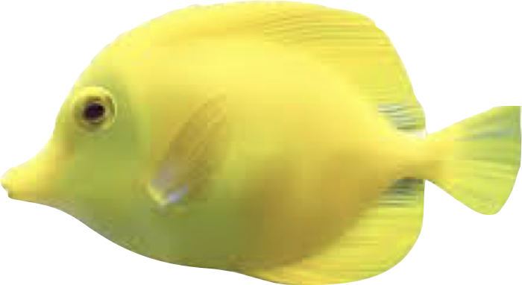
EEast
(fish)
eeast airhey
(a goldfish)
eeast beg bwee
(a small yellow fish)

Slide 8
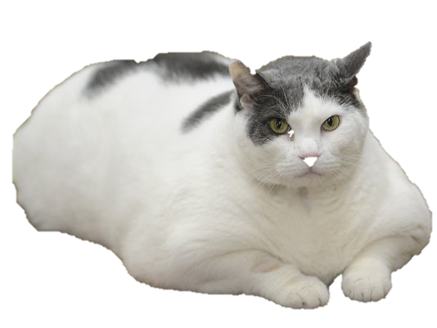
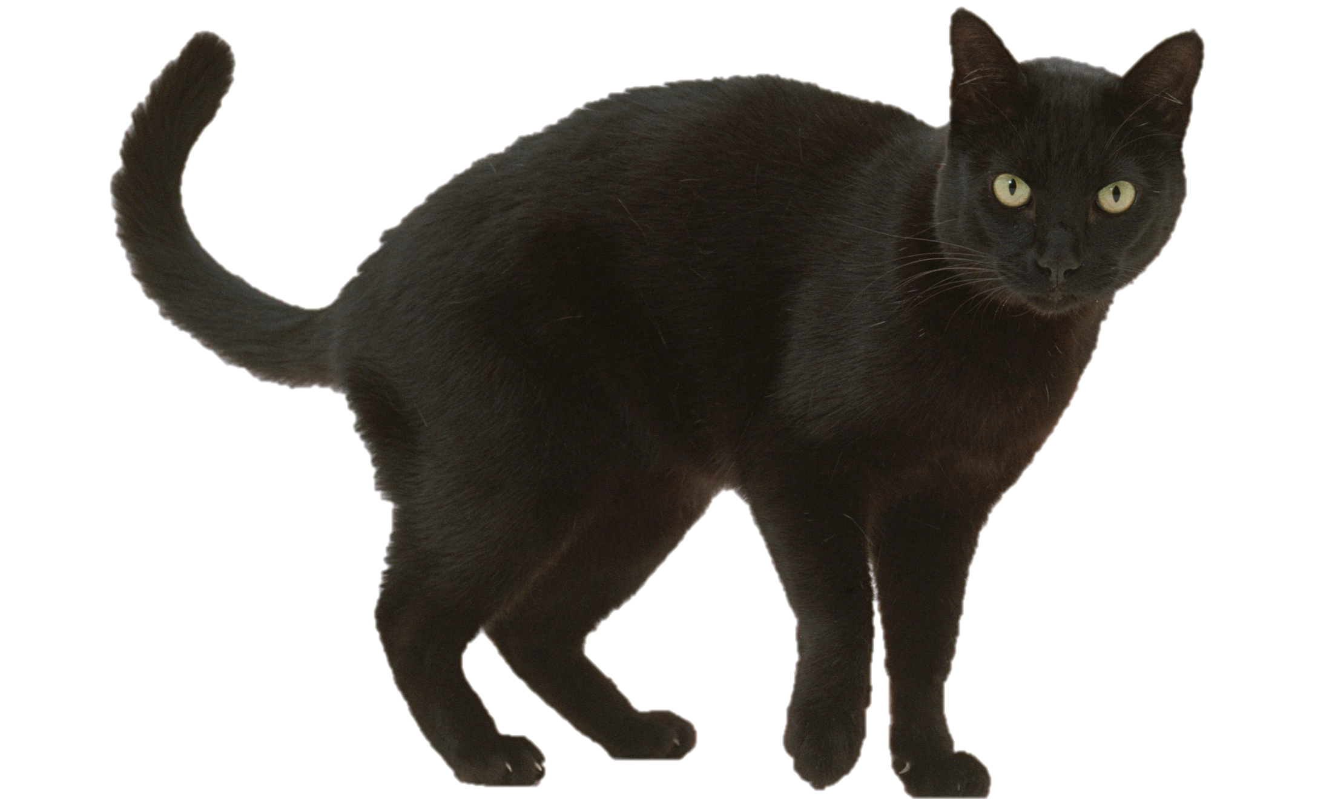
kayt
(cat)
kayt mooar
(a big cat)
kayt doo
(a black cat)
kayt beg
(a small cat)

Slide 9
Vooar Veg
Big
small
Vooar as Veg

Slide 10
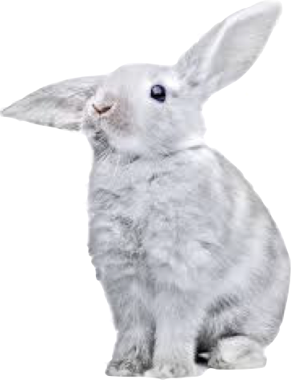
conning
(rabbit)
conning vooar bane
(a big white rabbit)
conning veg lheeah
(a small grey rabbit)

Slide 11
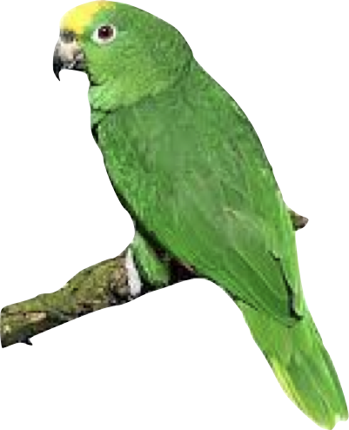
ushag
(bird)
ushag vooar glass
(a big green bird)
ushag veg
glass as bwee
(a small green and yellow bird)

Slide 12
Ta moddey dhone aym.
(I have a brown dog)

Slide 13
Ta eeast airhey aym
(I have a goldfish)

Slide 14
Ta kayt mooar doo aym
(I have a big black cat)

Slide 15
Cha nel conning vooar bane aym.
(I don’t have a big white rabbit)

Slide 16
Cha nel cabbyl mooar doo aym.
(I don’t have a big black horse)

Slide 17
Cha nel ushag veg glass as bwee aym.
(I don’t have a small green and yellow bird)

Slide 18
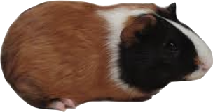
Ta kayt beg doo aym.
I have a small black cat.
kayt
conning (f)
cabbyl
ushag (f)
eeast (f)
beg
veg
mooar
vooar
muc rangagh (f)
moddey
dhone
ghone
doo
ghoo
bane
vane
glass
ghlass
gorrym
ghorrym
airhey
lheeah

