Slide 1
Er y Ghowaltys
On the Farm

Slide 2
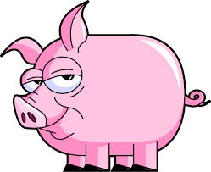
muc

Slide 3
Cre ren oo fakin er y ghowaltys?
(What did you see on the farm?)

Slide 4
Ren mee fakin muc.
(I saw a pig.)

Slide 5
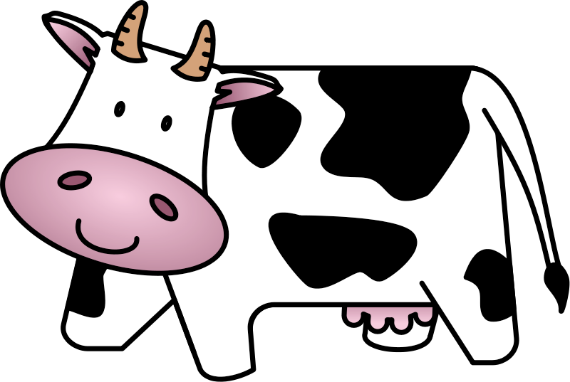
booa

Slide 6
Cre ren oo fakin er y ghowaltys?
(What did you see on the farm?)

Slide 7
Ren mee fakin booa.
(I saw a cow.)

Slide 8
keyrrey

Slide 9
Cre ren oo fakin er y ghowaltys?
(What did you see on the farm?)

Slide 10
Ren mee fakin keyrrey.
(I saw a sheep.)

Slide 11
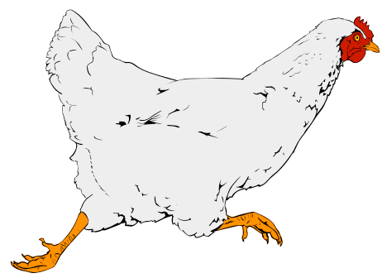
kiark

Slide 12
Cre ren oo fakin er y ghowaltys?
(What did you see on the farm?)

Slide 13
?
Ren mee fakin kiark.
(I saw a hen/chicken.)

Slide 14
soalt

Slide 15
Cre ren oo fakin er y ghowaltys?
(What did you see on the farm?)

Slide 16
?
Ren mee fakin soalt.
(I saw a barn.)

Slide 17
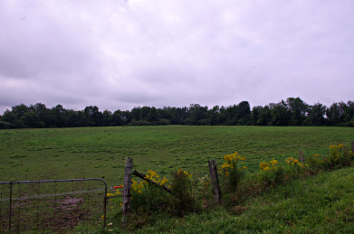
magher

Slide 18
Ren oo fakin magher er y ghowaltys?
(Did you see a field on the farm?)

Slide 19
Ren mee fakin magher er y ghowaltys.
(I did see a field on the farm.)

Slide 20
Cha ren mee fakin magher er y ghowaltys.
(I didn’t see a field on the farm.)

Slide 21
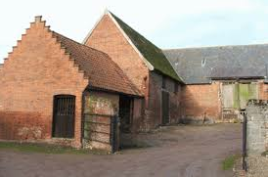
close

Slide 22
Ren oo fakin close er y ghowaltys?
(Did you see a farmyard on the farm?)

Slide 23
Ren mee fakin close er y ghowaltys.
(I did see a farmyard on the farm.)

Slide 24
Cha ren mee fakin close er y ghowaltys.
(I didn’t see a farmyard on the farm.)

Slide 25
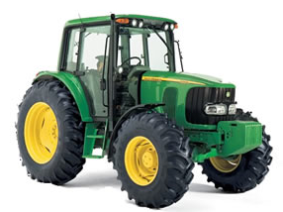
tayrneyder

Slide 26
Ren oo fakin tayrneyder er y ghowaltys?
(Did you see a tractor on the farm?)

Slide 27
Ren mee fakin tayrneyder er y ghowaltys.
(I did see a tractor on the farm.)
?

Slide 28
Cha ren mee fakin tayrneyder er y ghowaltys.
(I didn’t see a tractor on the farm.)
?

Slide 29
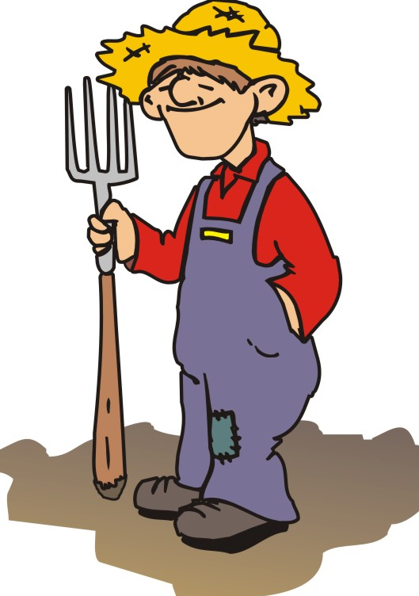
eirinagh

Slide 30
Ren oo fakin eirinagh er y ghowaltys?
(Did you see a farmer on the farm?)

Slide 31
Ren mee fakin eirinagh er y ghowaltys.
(I did see a farmer on the farm.)
?

Slide 32
Cha ren mee fakin eirinagh er y ghowaltys.
(I didn’t see a farmer on the farm.)
?

Slide 33
Jeant!
Done!

Slide 34
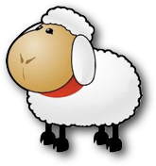
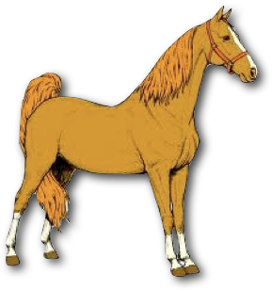
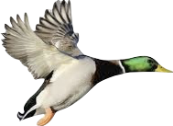
Traa son arrane! (Time for a song!)
Er y ghowaltys (On the farm)
Er y ghowaltys, honnick mee booa
C’red v’ee gra? Moo, moo.
Moo, moo, moo,
Moo, moo, moo.
C’red v’ee gra?
Moo, moo.
Er y ghowaltys, honnick mee kirree
C’red v’ad gra? Baa, baa.
Baa, baa, baa,
Baa, baa, baa.
C’red v’ee gra?
Baa, baa.
Er y ghowaltys, honnick mee cabbyl
C’red v’eh gra? Naa, naa.
Naa, naa, naa,
Naa, naa, naa.
C’red v’eh gra?
Naa, naa.
Er y ghowaltys, honnick mee thunnag
C’red v’ee gra? Quack, quack.
Quack, quack, quack,
Quack, quack, quack.
C’red v’ee gra?
Quack, quack.
On the farm I saw a (cow/some sheep). What did it/they say?
[honnick mee = ren mee fakin = I saw]

Slide 35
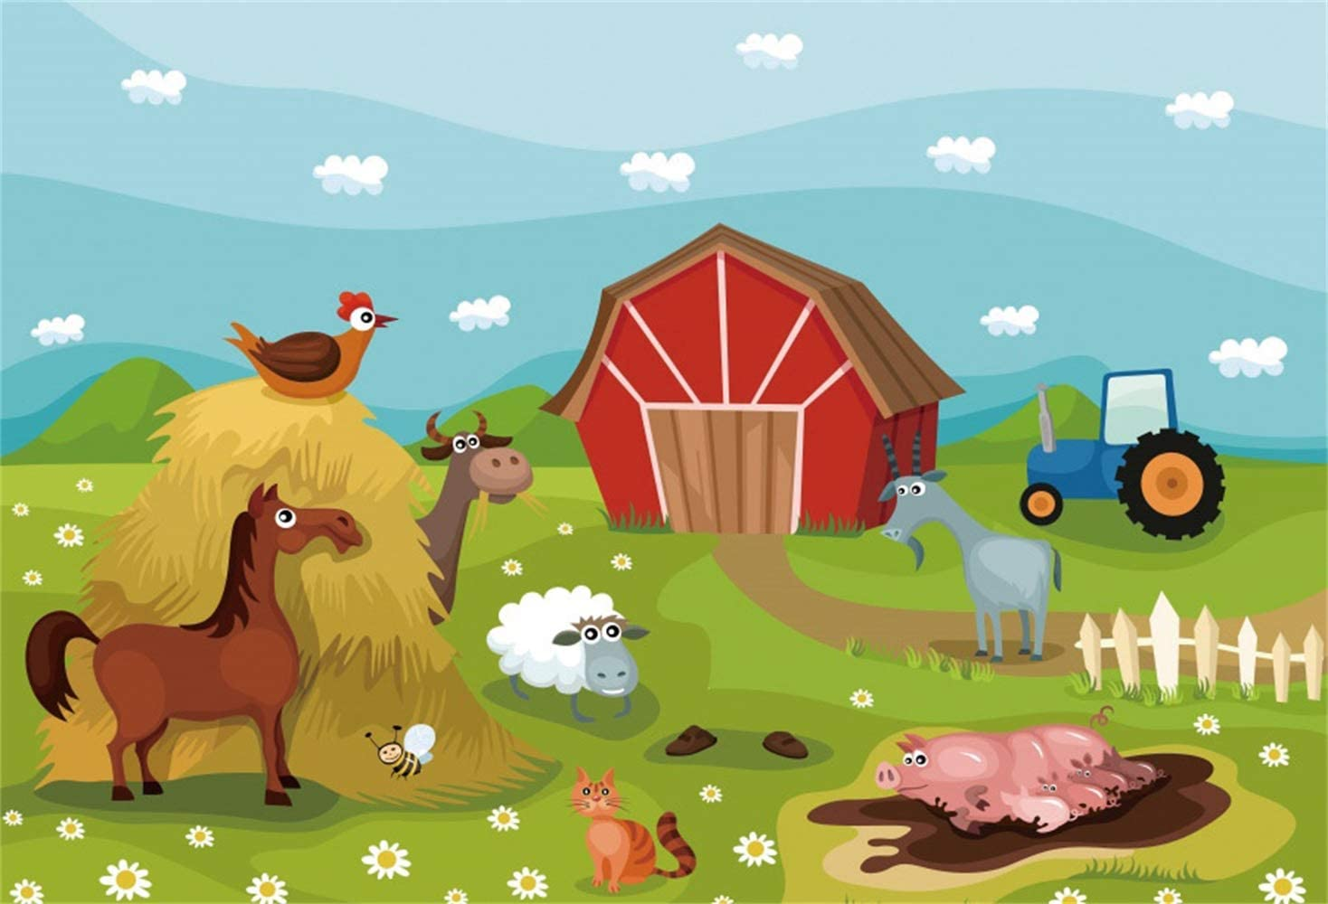
Cre ren oo fakin er y ghowaltys?
Ren mee fakin … as … Cha ren mee fakin...
(I saw… and …) (I didn’t see…)

Slide 36
Cre ren oo fakin er y ghowaltys?
muc
booa
keyrrey
kiark
eirinagh
soalt
magher
close
tayrneyder
Ren mee fakin … , … , … , as … er y ghowaltys.
Cha ren mee fakin … as … . (as = and)

