Slide 1
Er y Ghowaltys - Gamman
On the Farm - Game
In this game, you can practise the words and phrases you learnt in PowerPoint 5.1. Click on the picture which matches the word/phrase.
Click to the next slide for a quick recap.

Slide 2
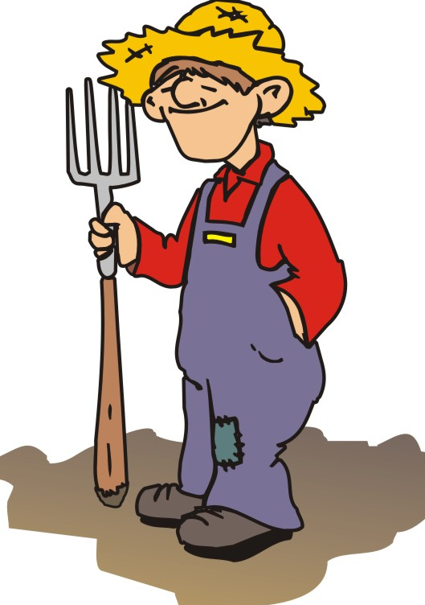
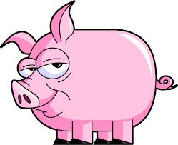
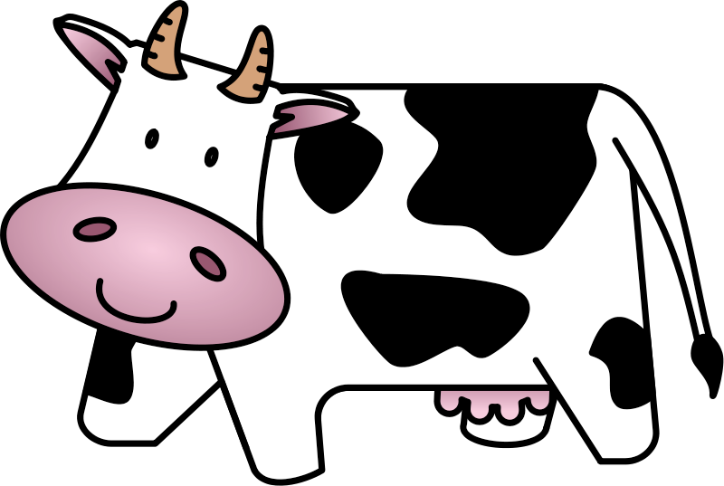
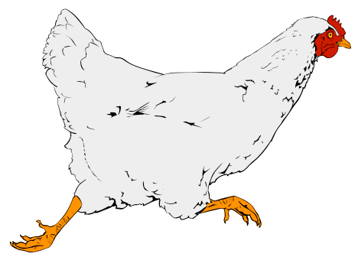
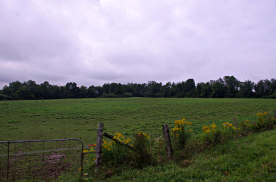
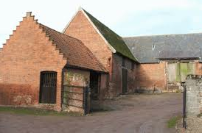
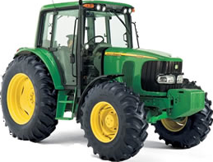
Ren mee fakin … . (I saw a … .)
Cha ren mee fakin … (I didn’t see a… .)
gowaltys
muc
booa
keyrrey
kiark
eirinagh
soalt
magher
close
tayrneyder
Click to start the game.

Slide 3
gowaltys

Slide 5
Ren mee fakin booa.

Slide 7
Ren mee fakin soalt.

Slide 9
Ren mee fakin muc.

Slide 11
Cha ren mee fakin kiark.

Slide 13
Ren mee fakin keyrrey.

Slide 15
Ren mee fakin tayrneyder er y ghowaltys.

Slide 17
Cha ren mee fakin magher er y ghowaltys.

Slide 19
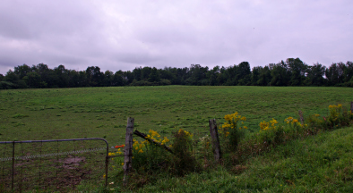
Cha ren mee fakin close er y ghowaltys.

Slide 21
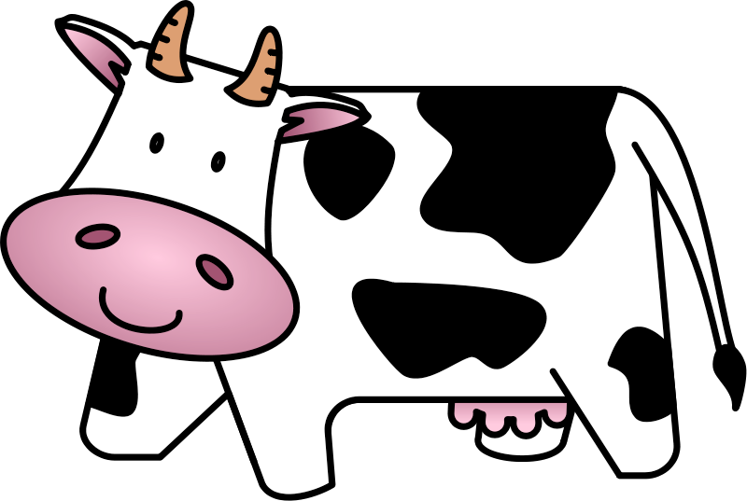
Ren mee fakin eirinagh er y ghowaltys.

Slide 23
Jeant!
Done!

