Slide 1
Gaelg

Slide 2
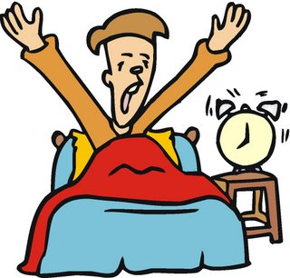

Slide 3
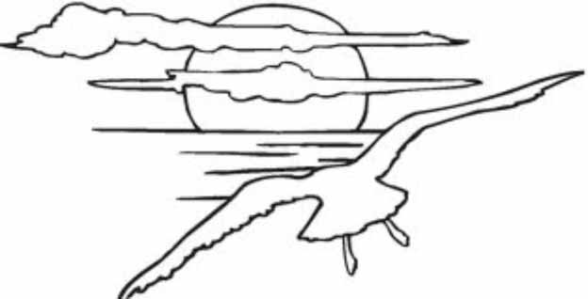

Slide 5
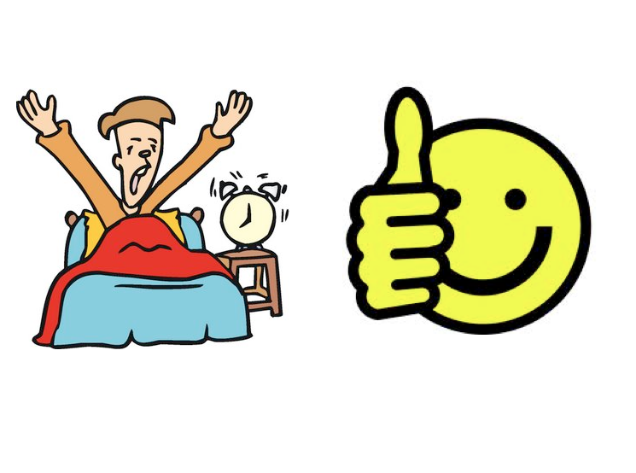

Slide 11
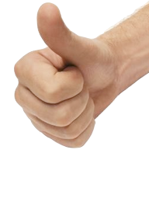

Slide 25
Gaelg

Slide 26
Slane!

Slide 27
Kys t’ou? - Ta mee... How are you? – I am…
braew
(fine)
maynrey
(happy)
feayr
(cold)
skee
(tired)
trimshagh
(sad)

